Slide 1
Deep Learning (CS 898-BD)
Fall 2023
Dr. Shruti Kshirsagar

Slide 2
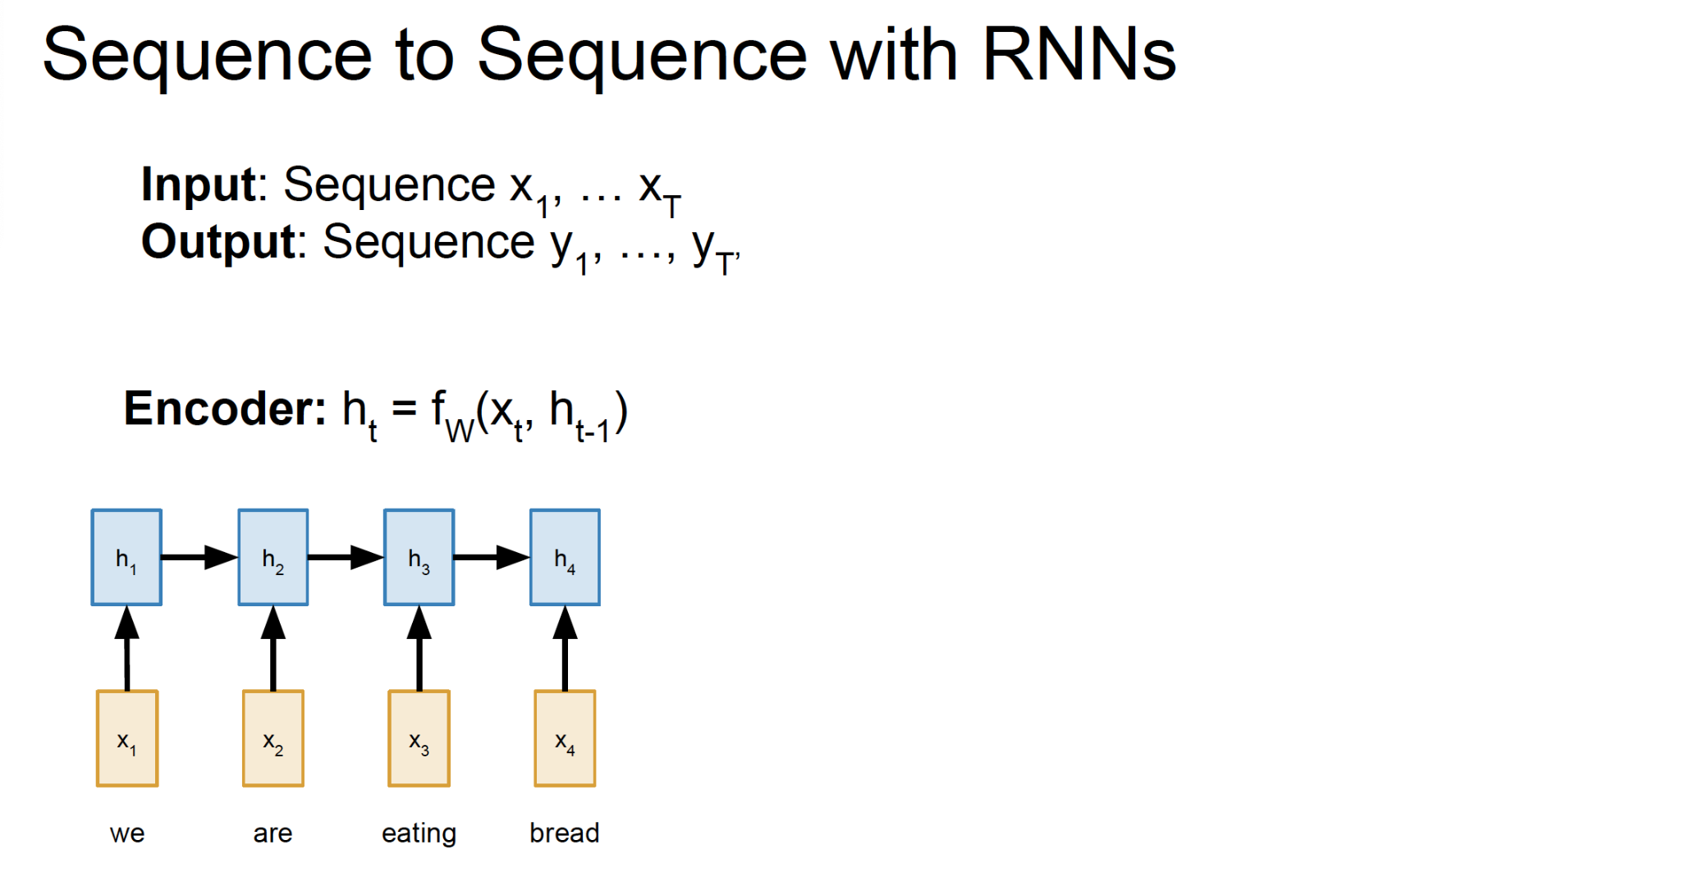
RNN

Slide 3
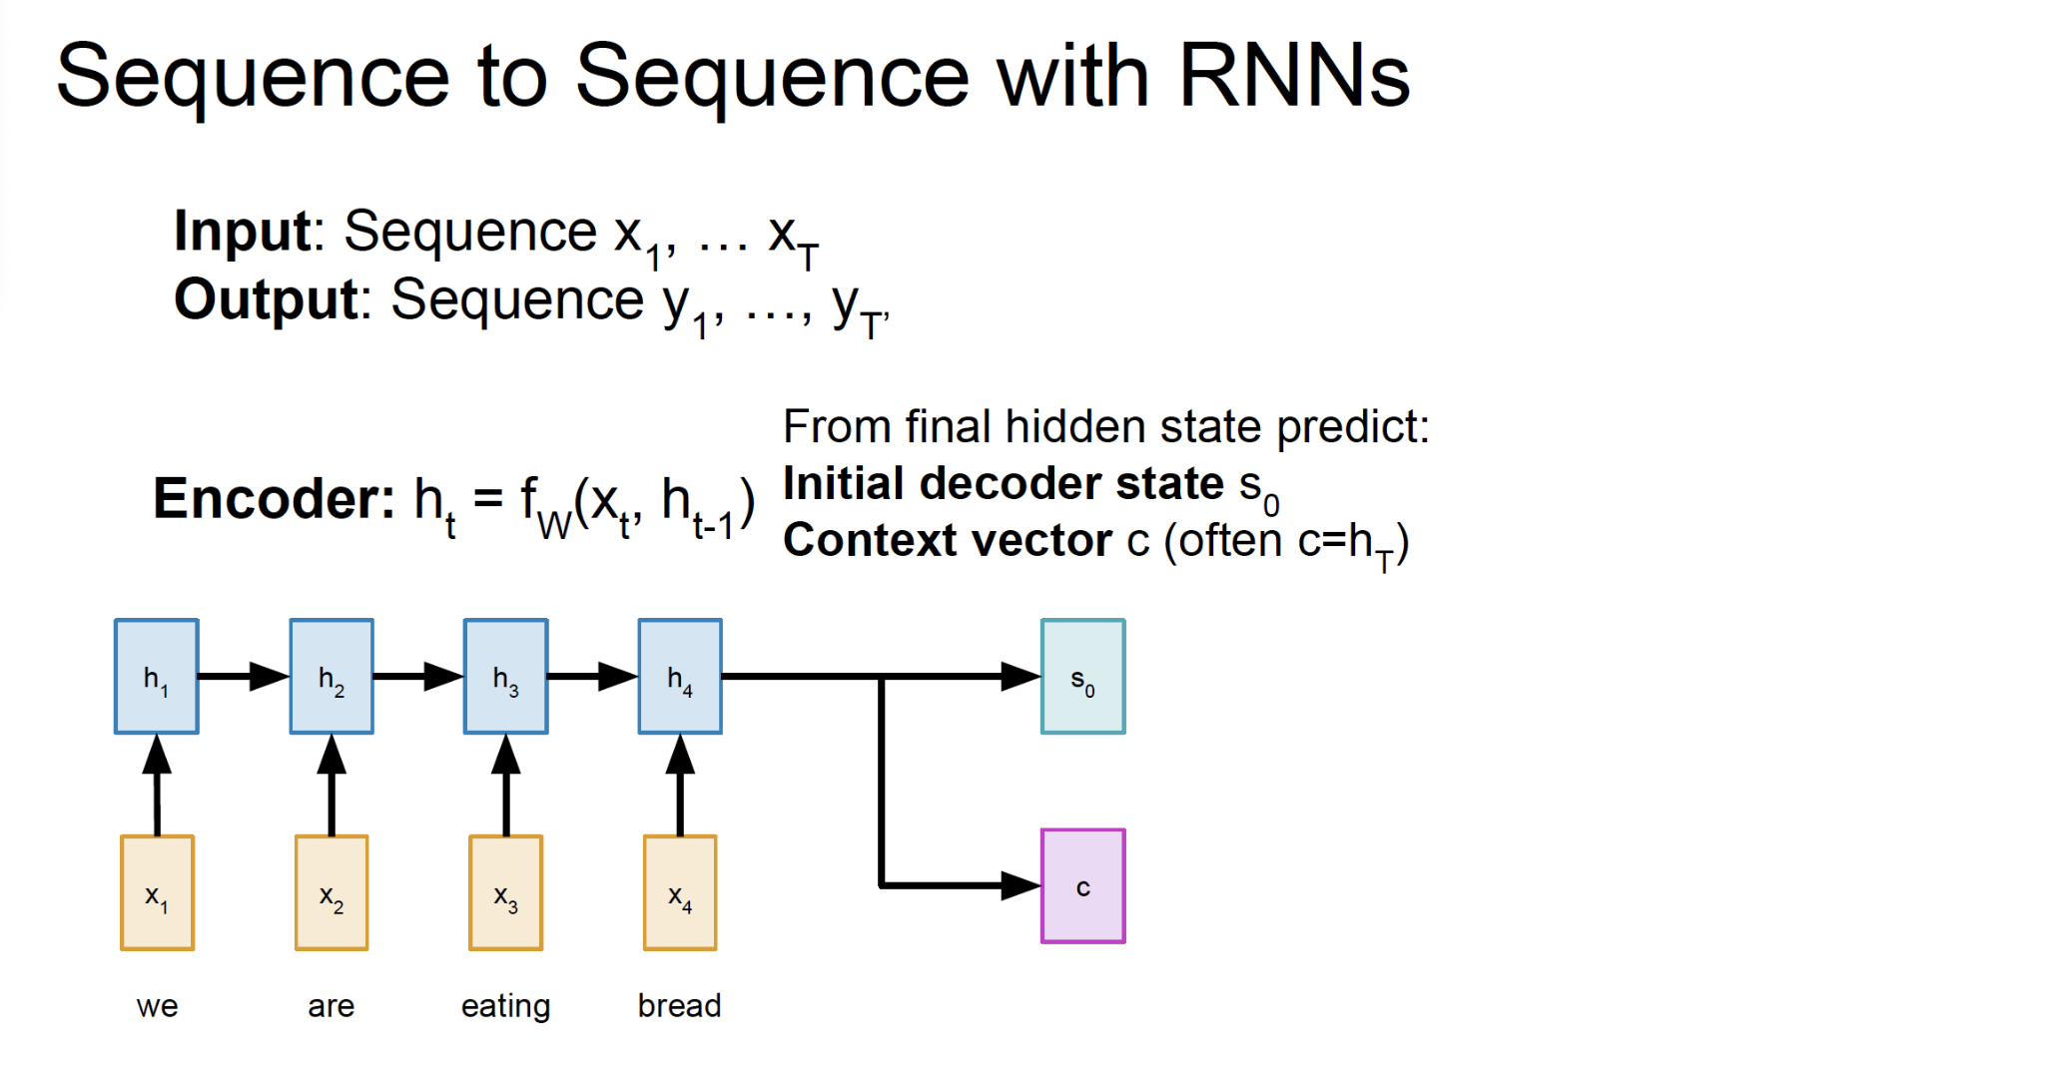
RNN

Slide 4
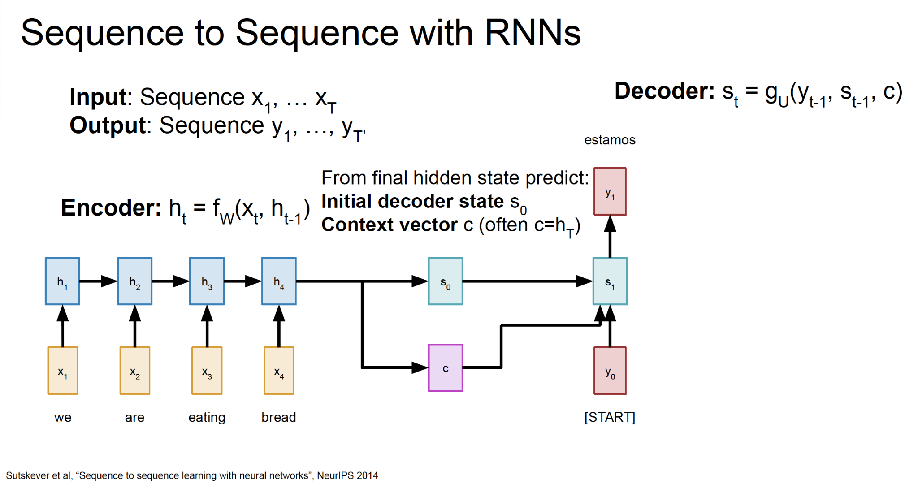
RNN

Slide 5
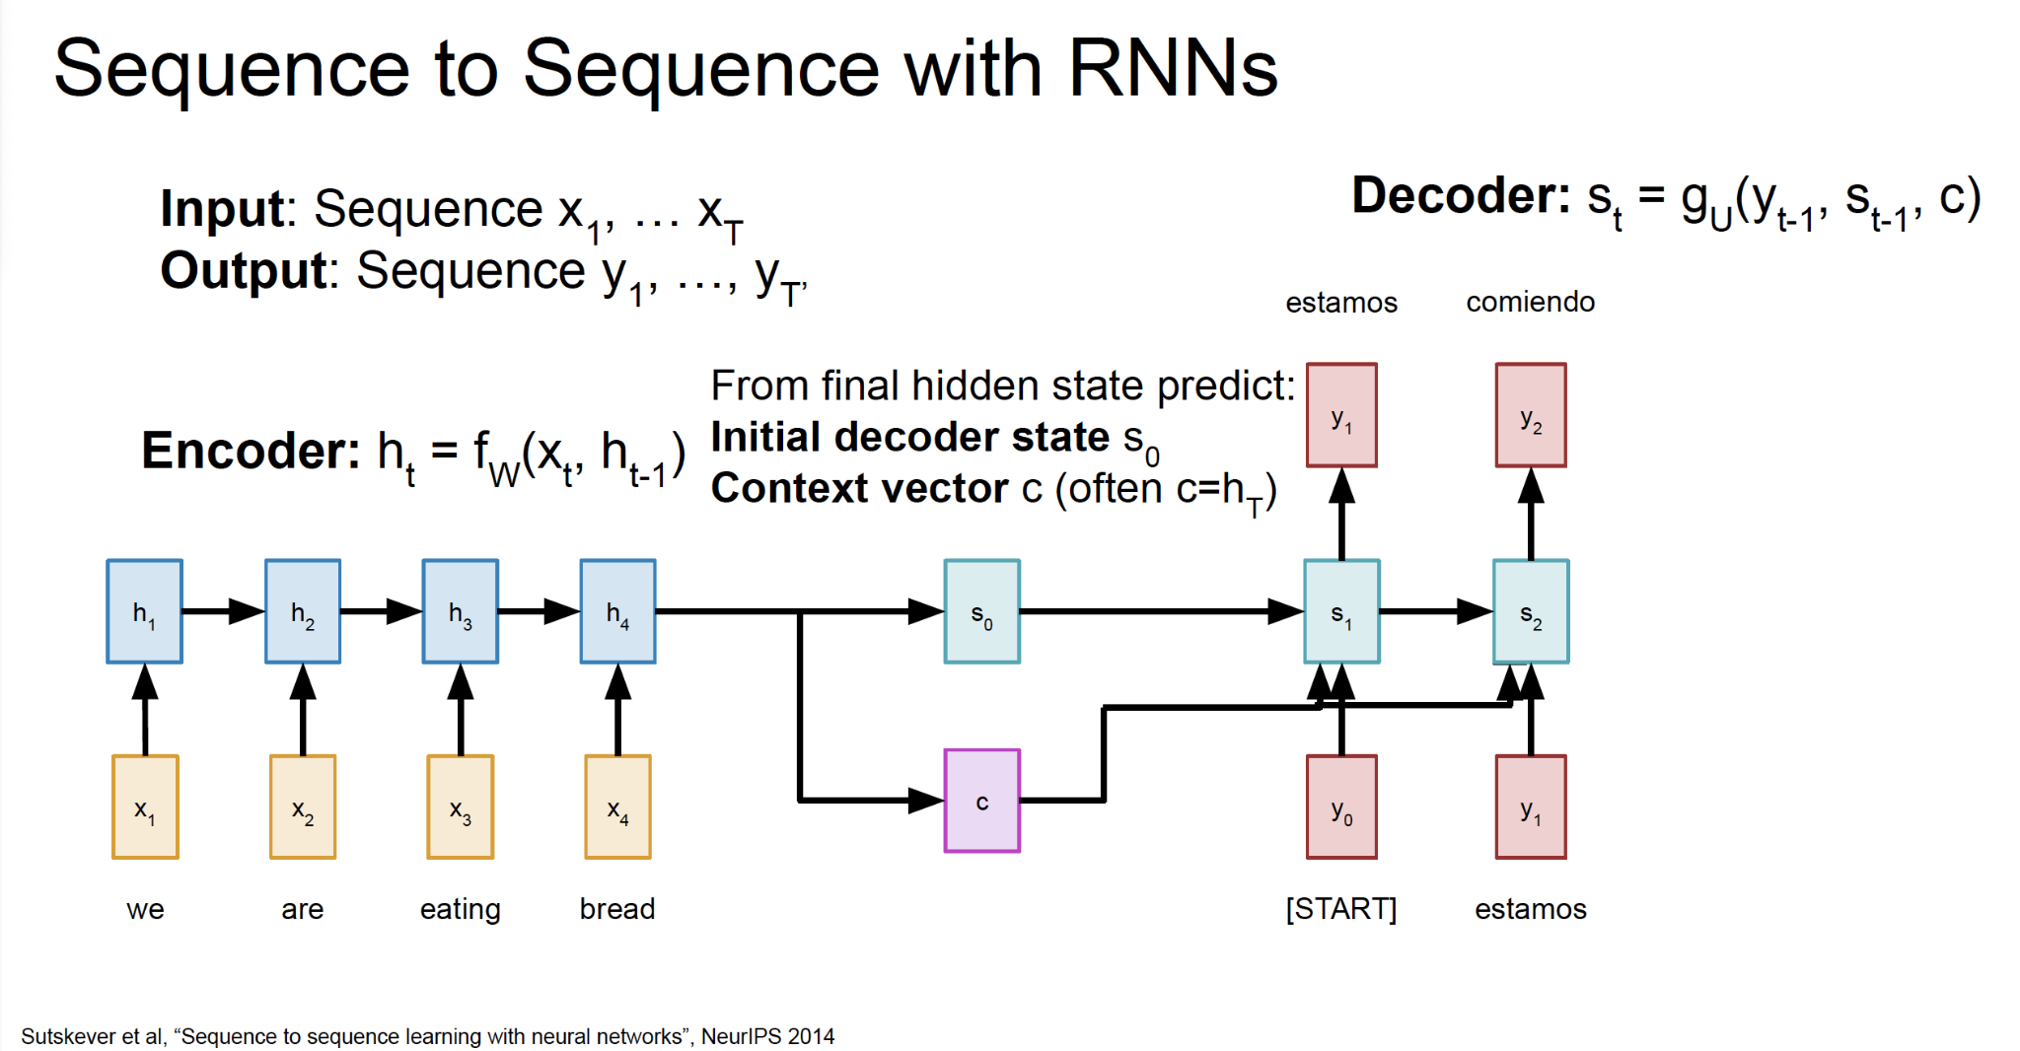
RNN

Slide 6
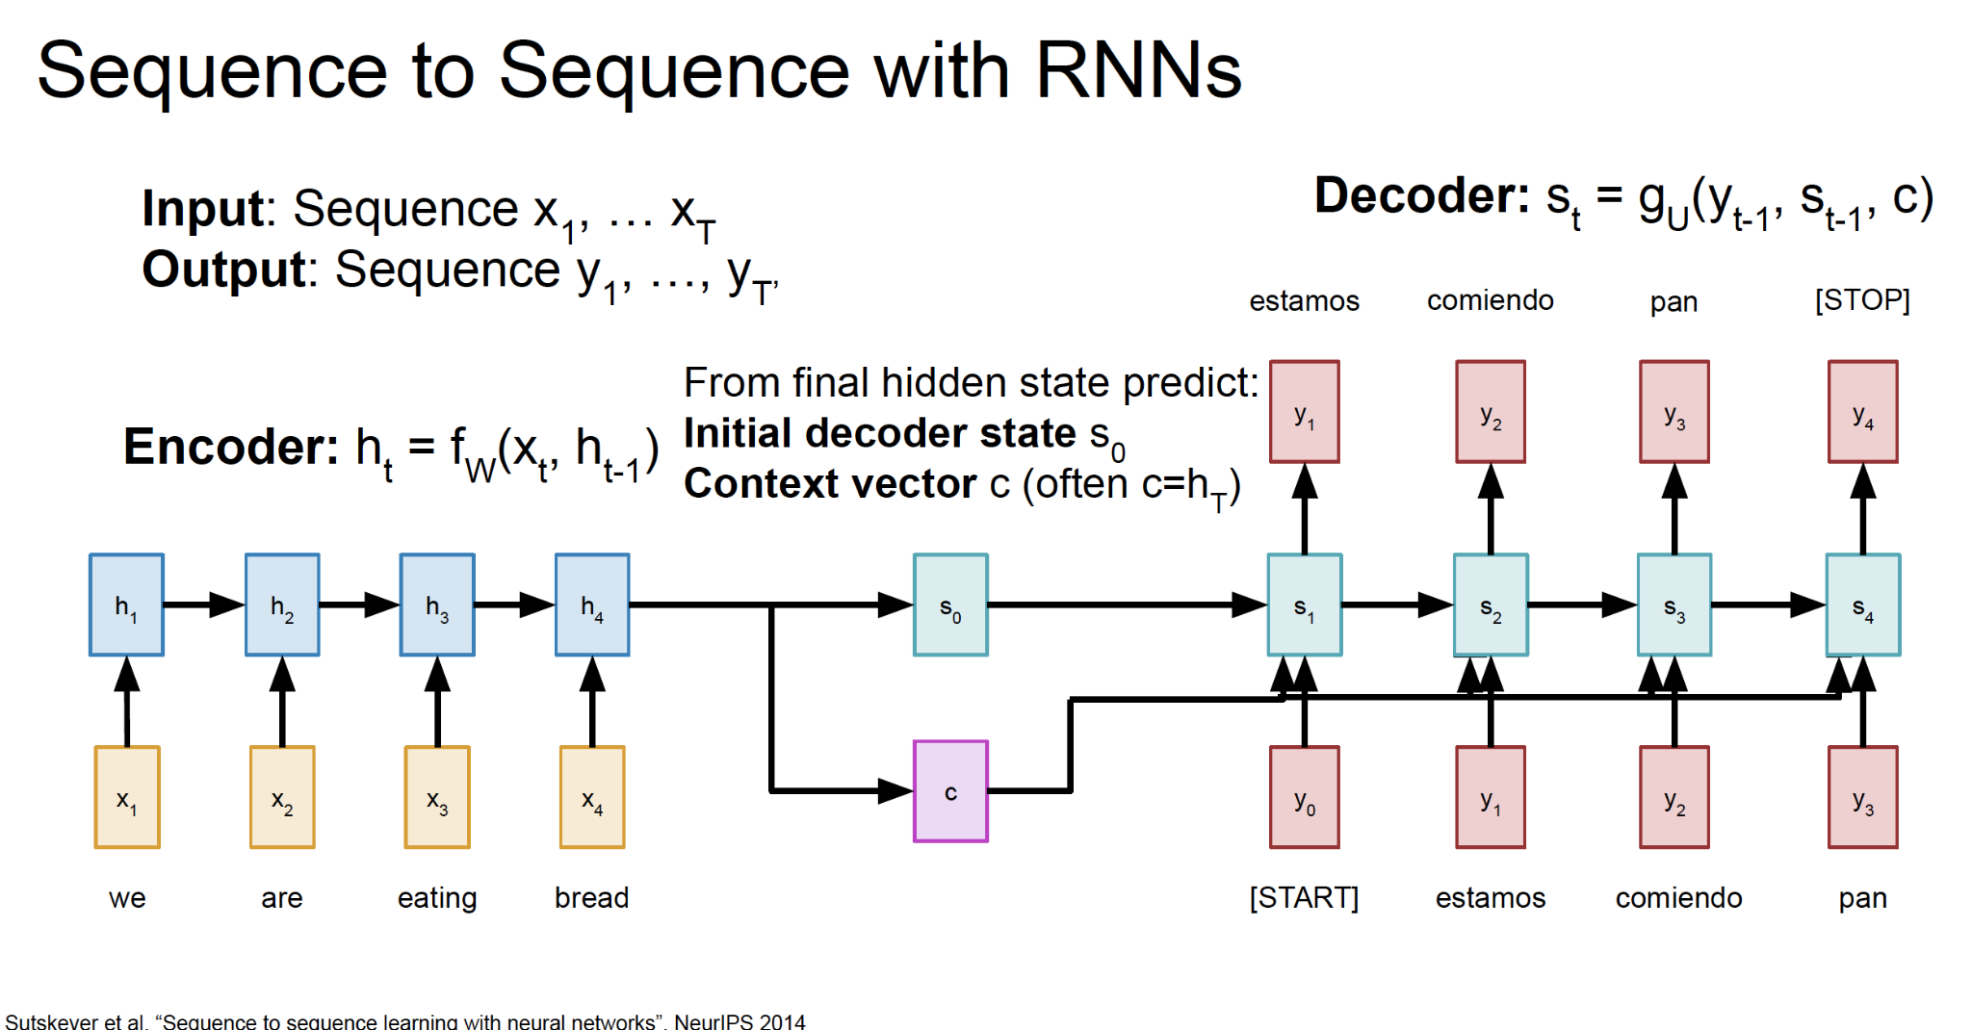
RNN

Slide 7
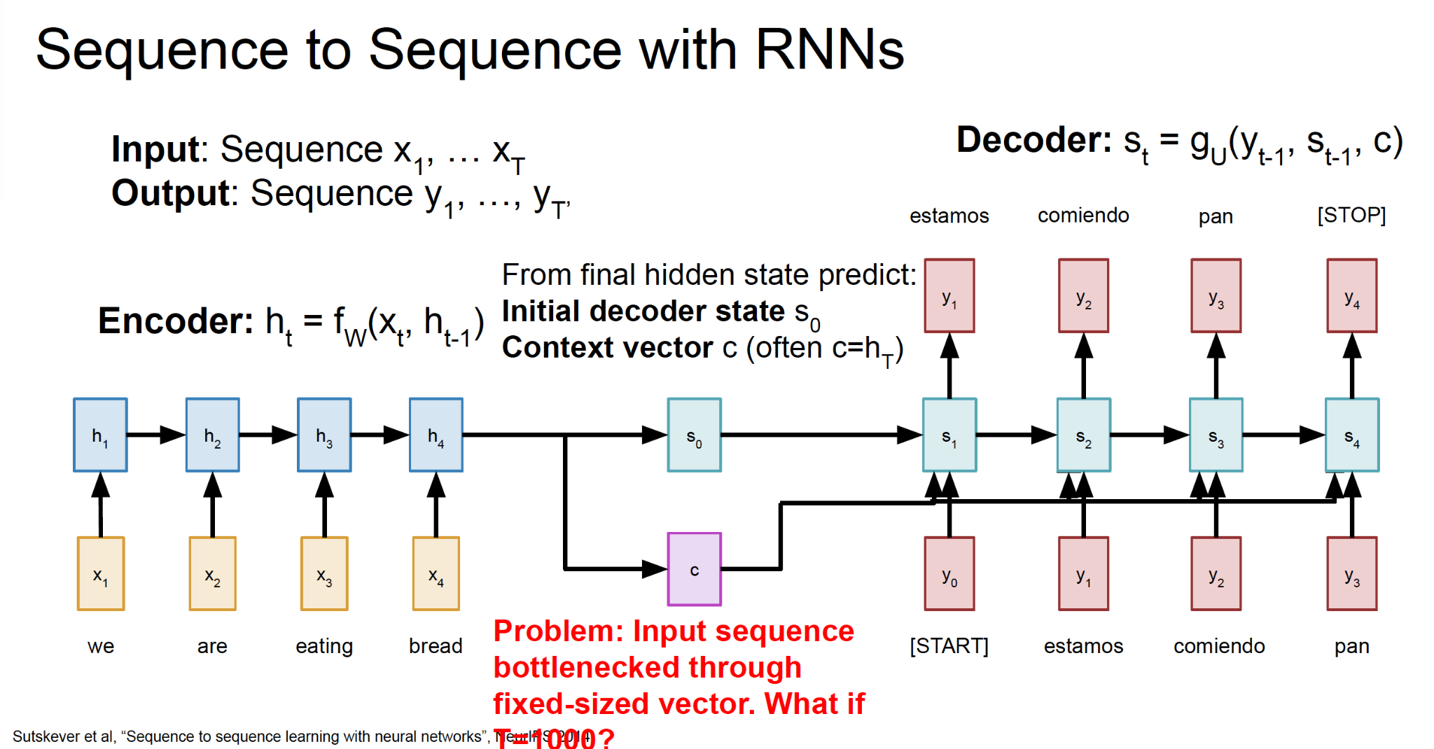
RNN

Slide 8
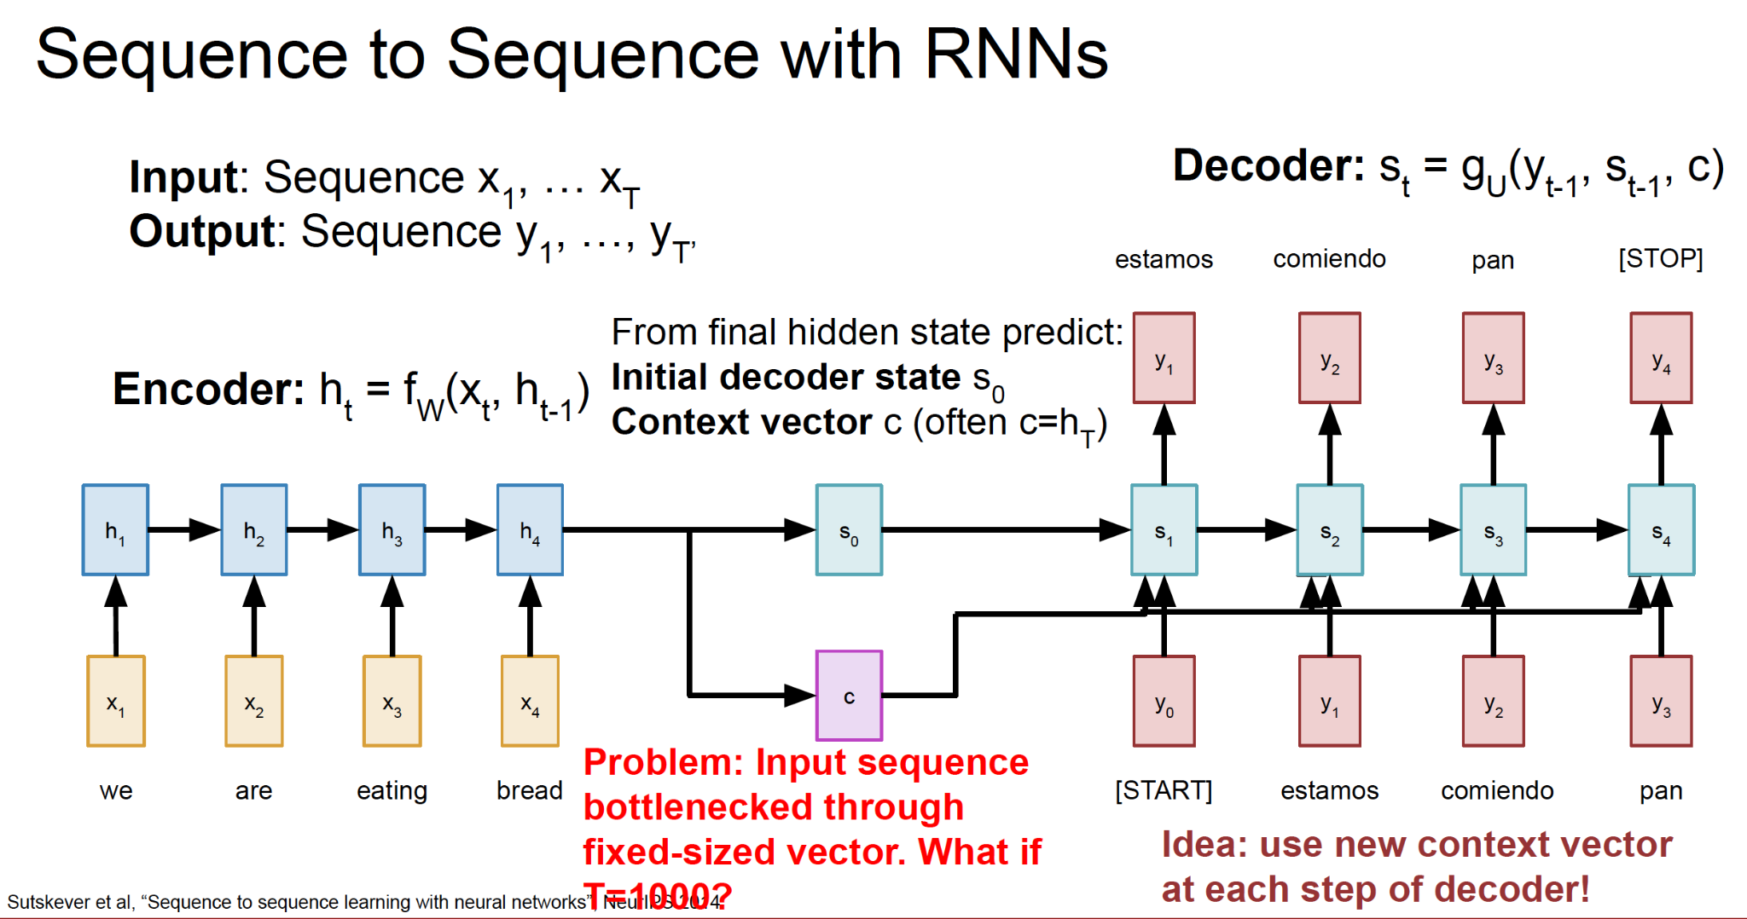
RNN

Slide 9
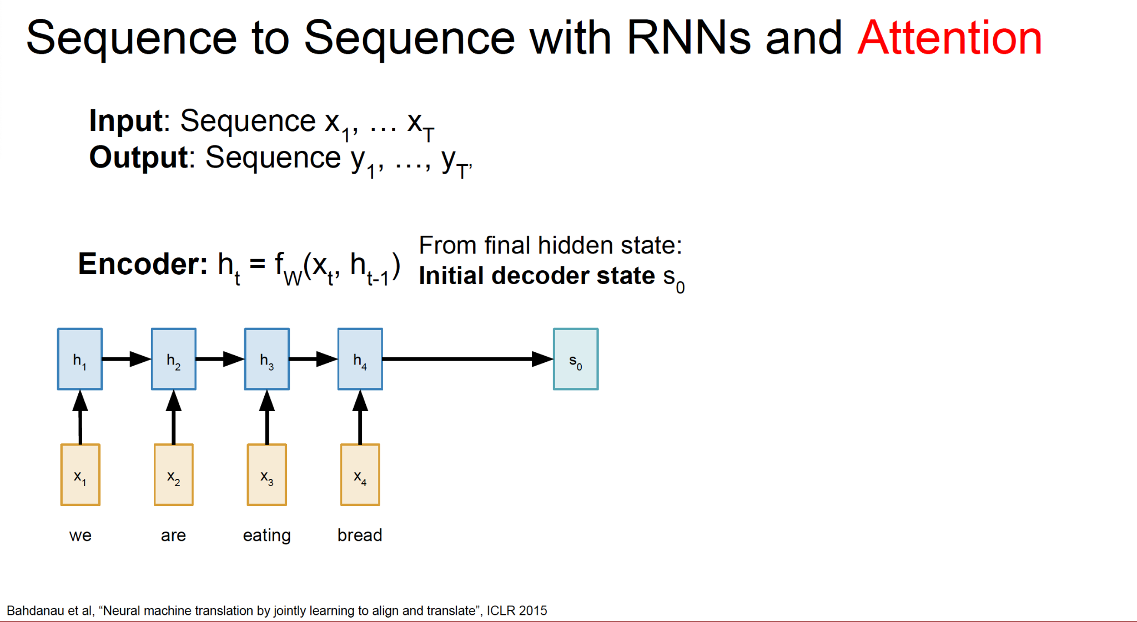
RNN and Attention

Slide 10
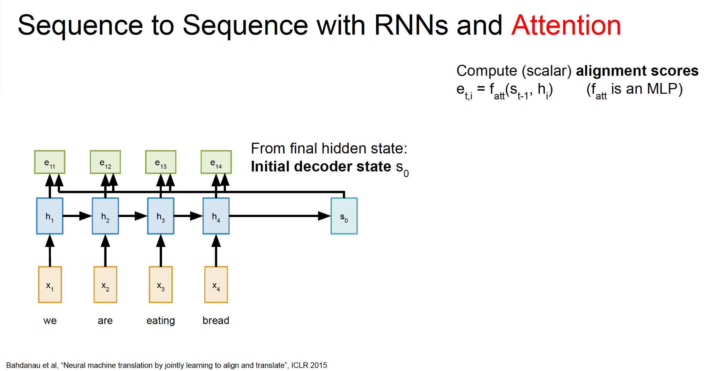
RNN and Attention

Slide 11
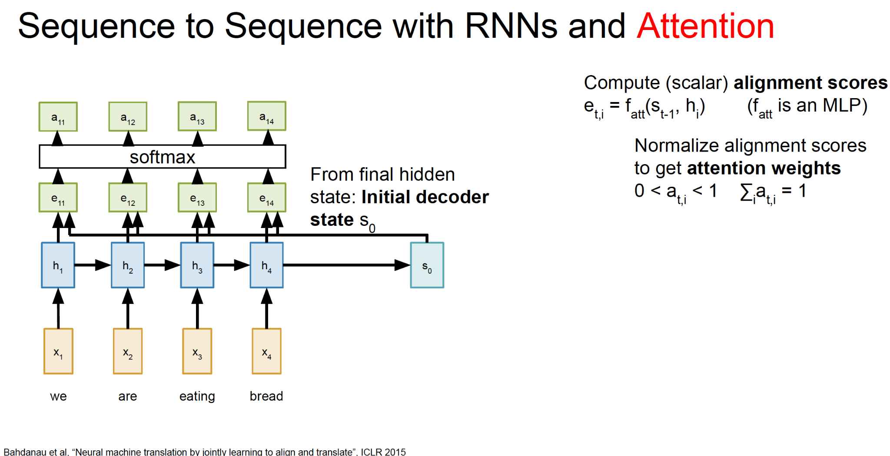
RNN and Attention

Slide 12
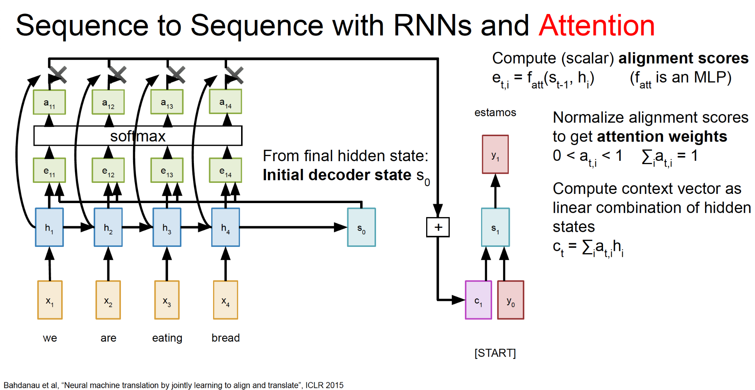
RNN and Attention

Slide 13
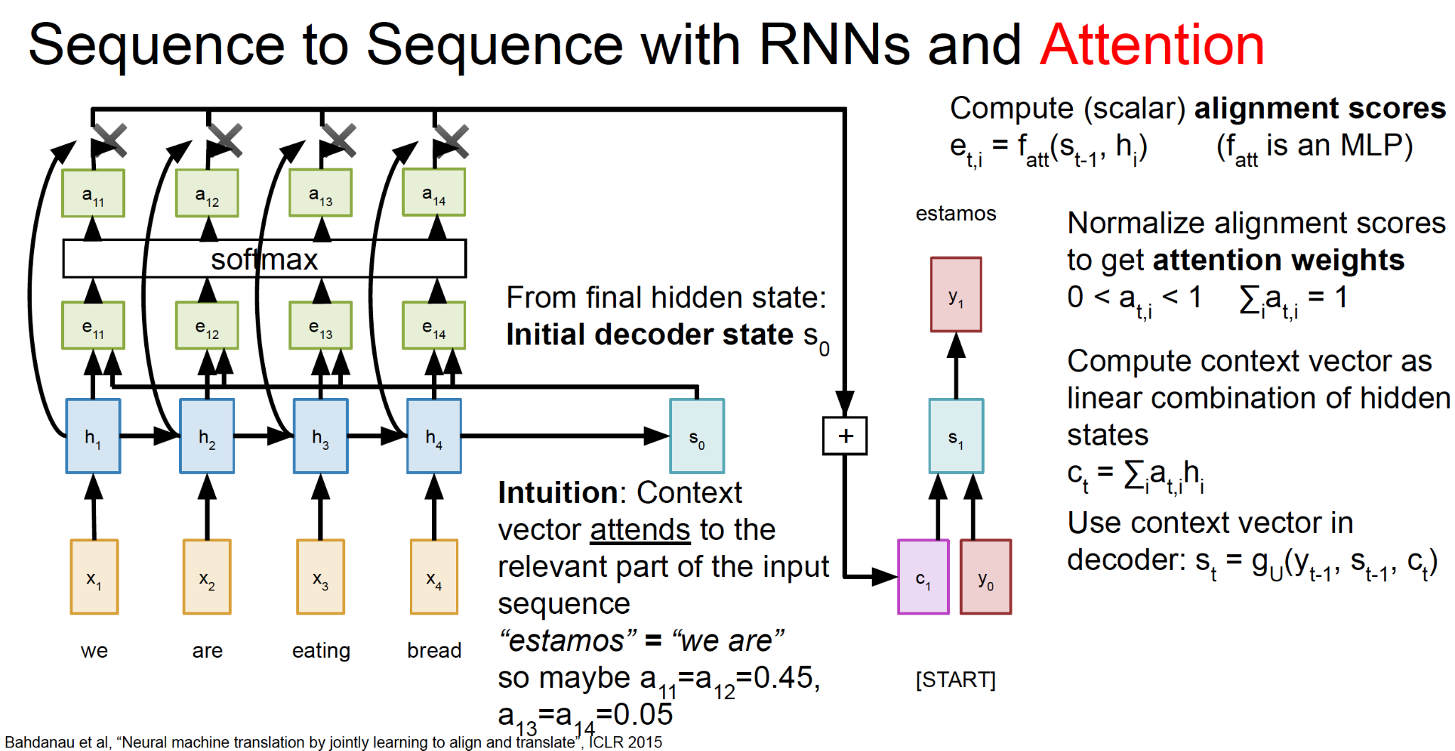
RNN and Attention

Slide 14
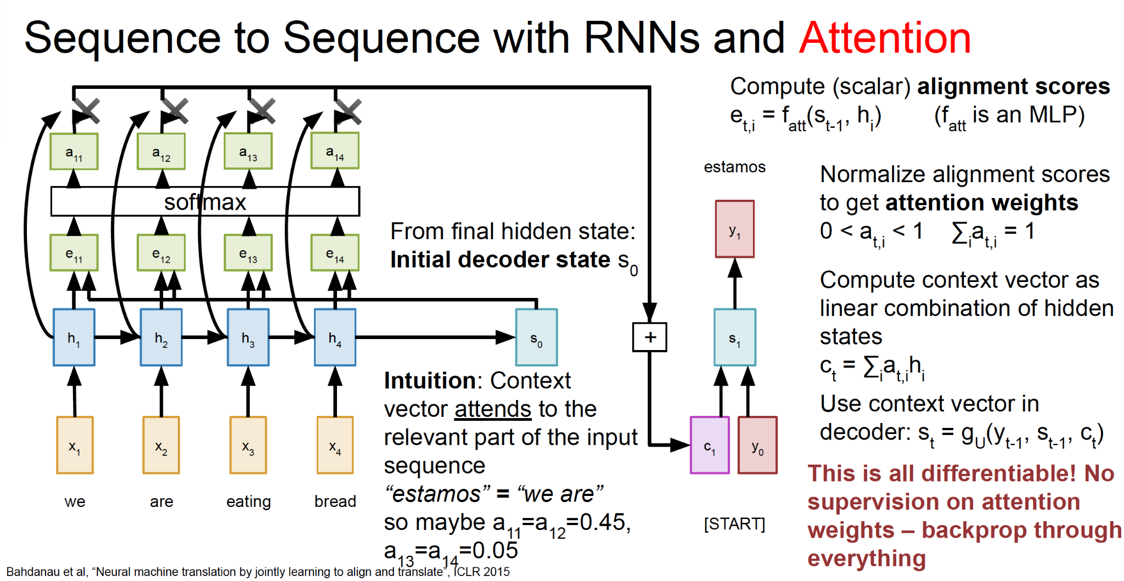
RNN and Attention

Slide 15
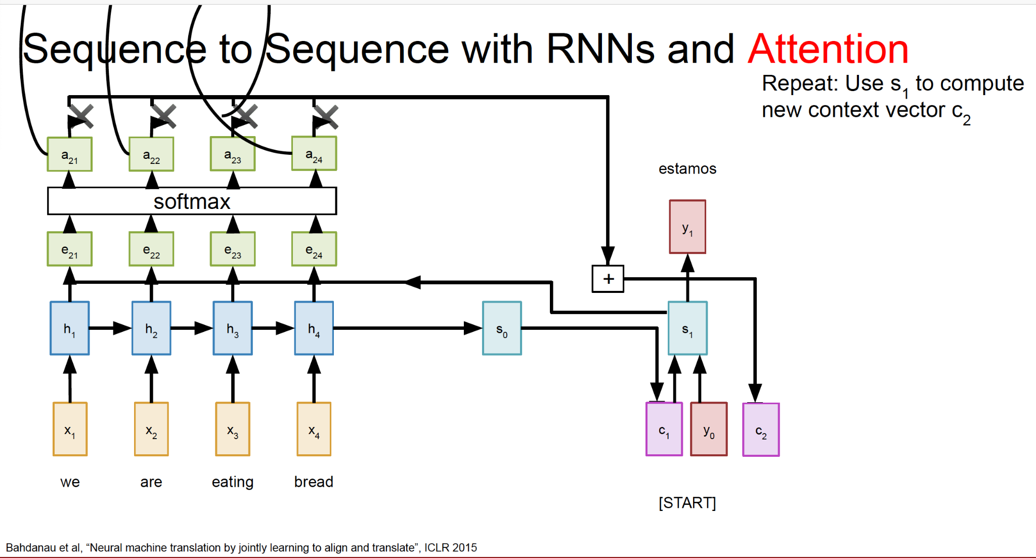
RNN and Attention

Slide 16
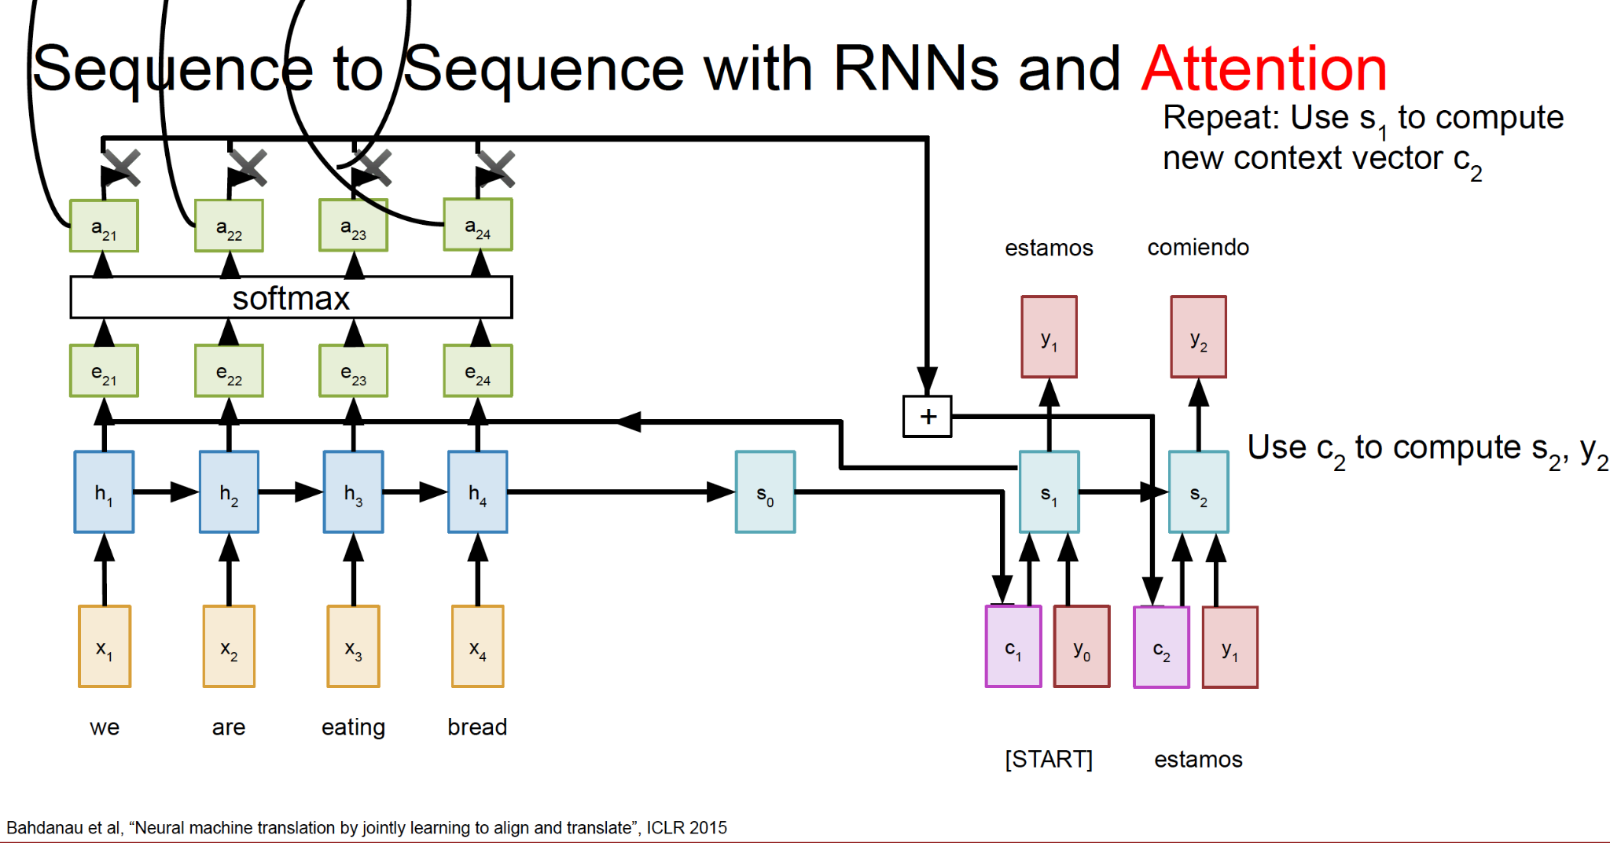
RNN and Attention

Slide 17
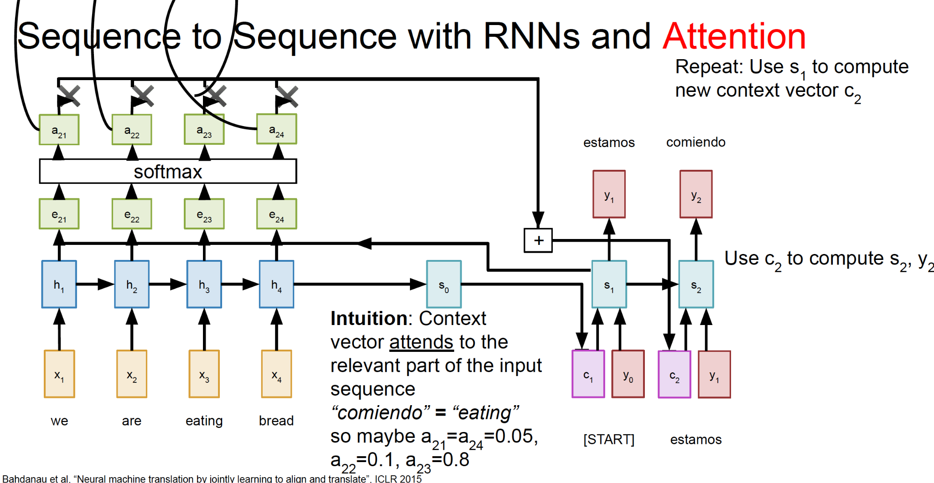
RNN and Attention

Slide 18
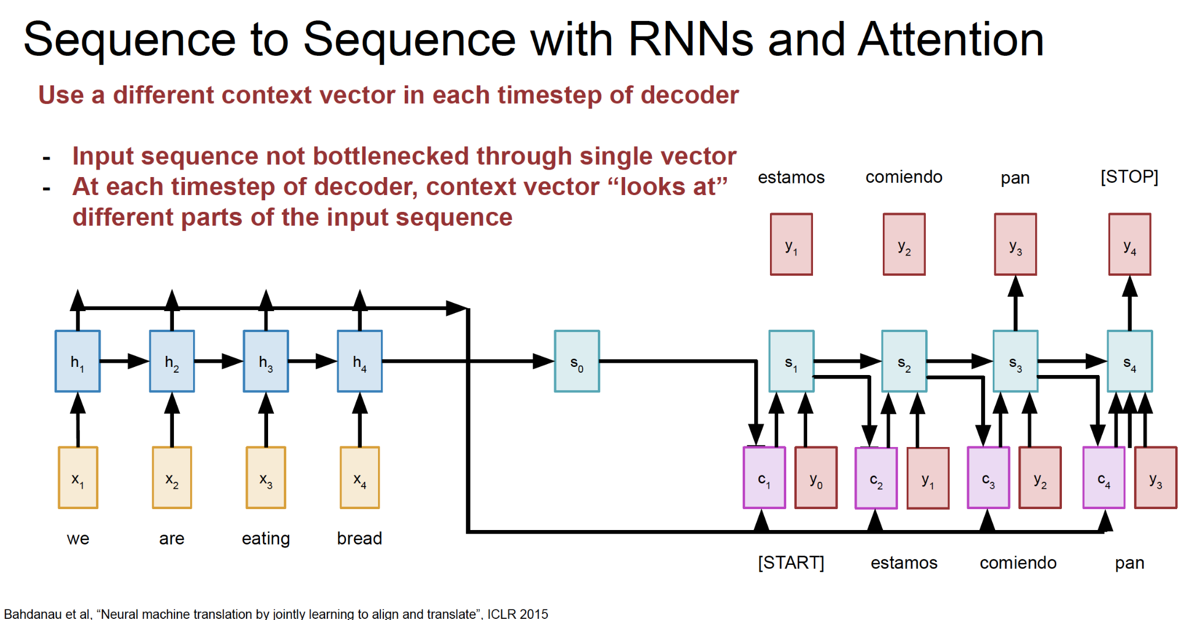
RNN and Attention

Slide 19
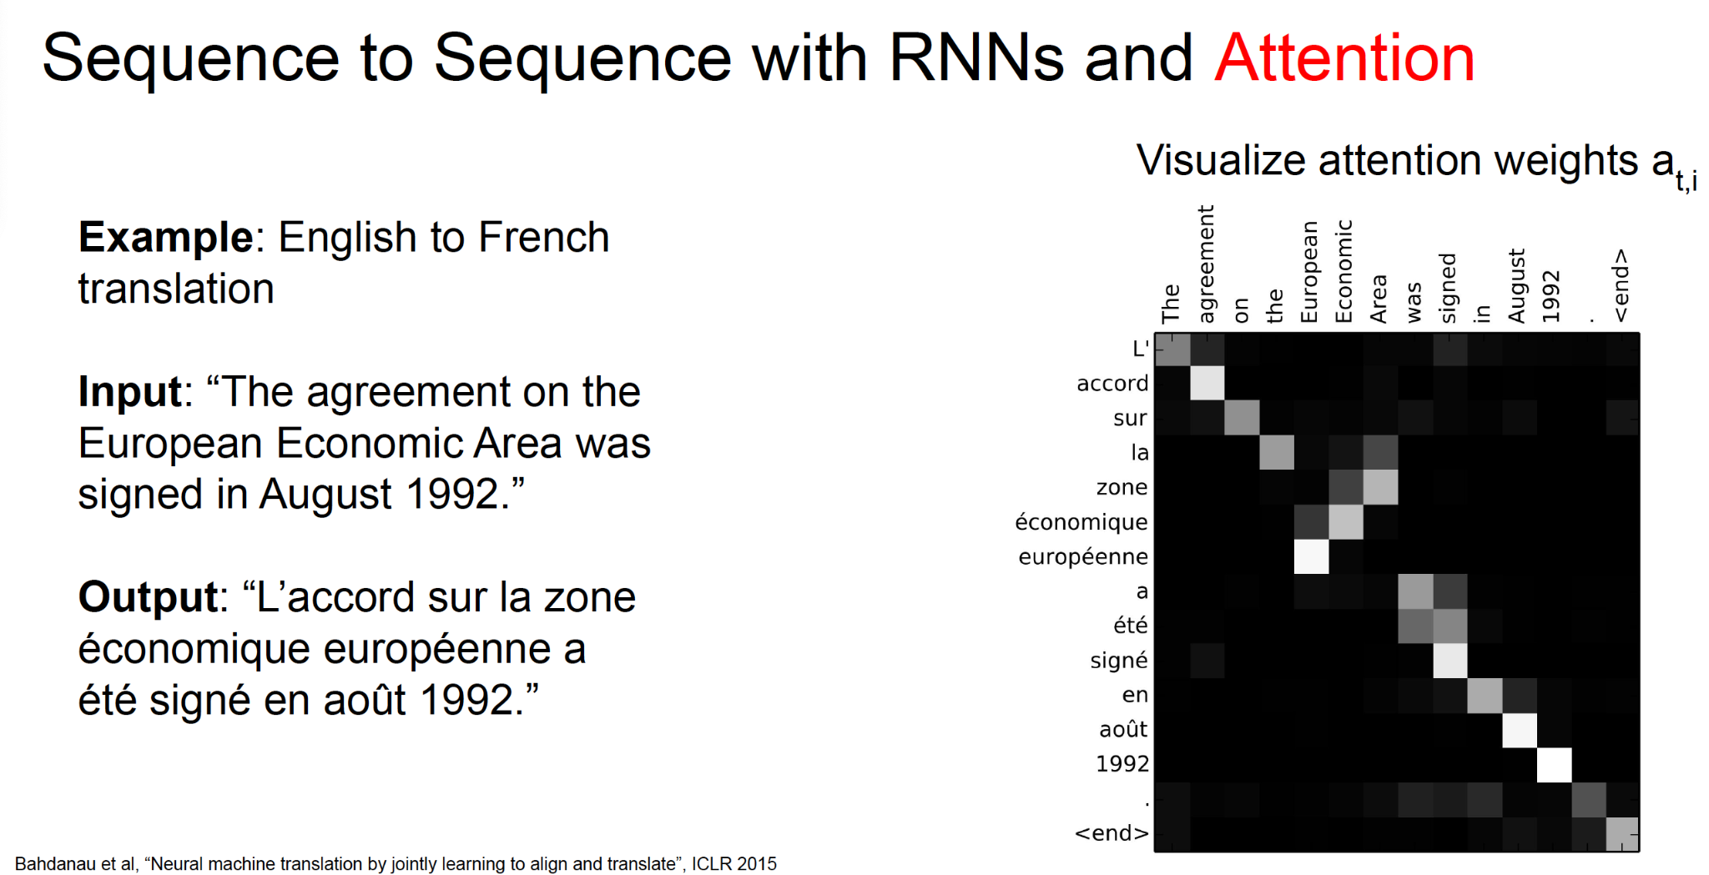
RNN and Attention

Slide 20
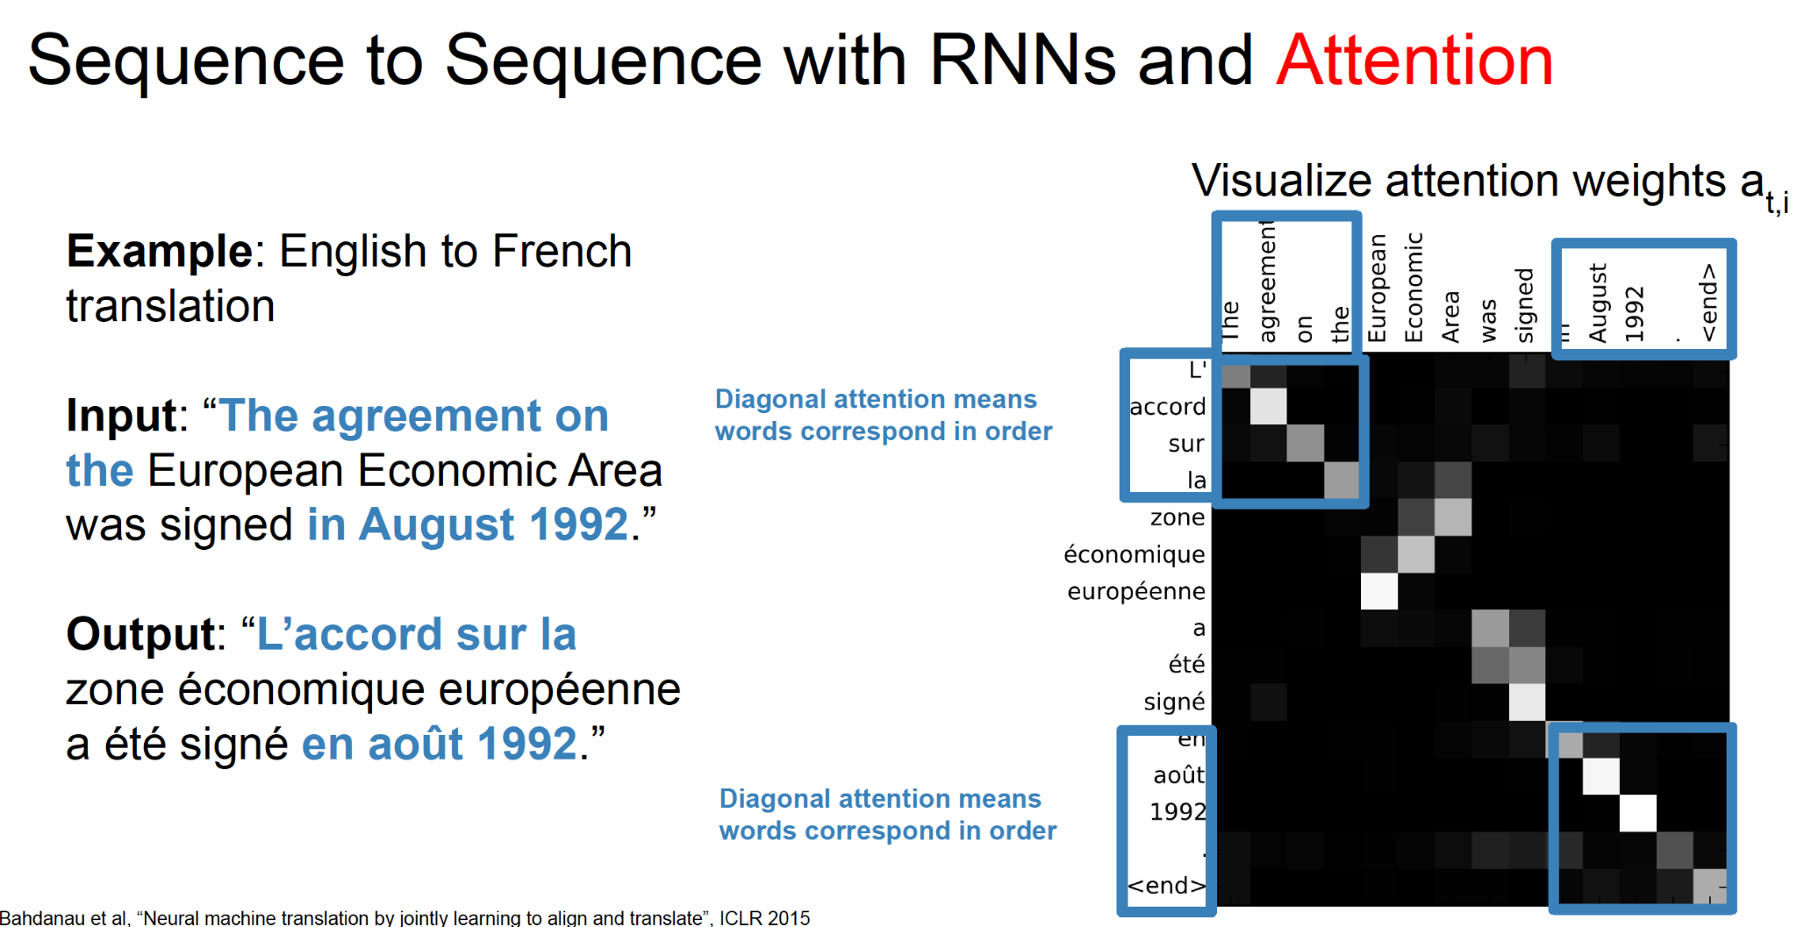
RNN and Attention

Slide 21
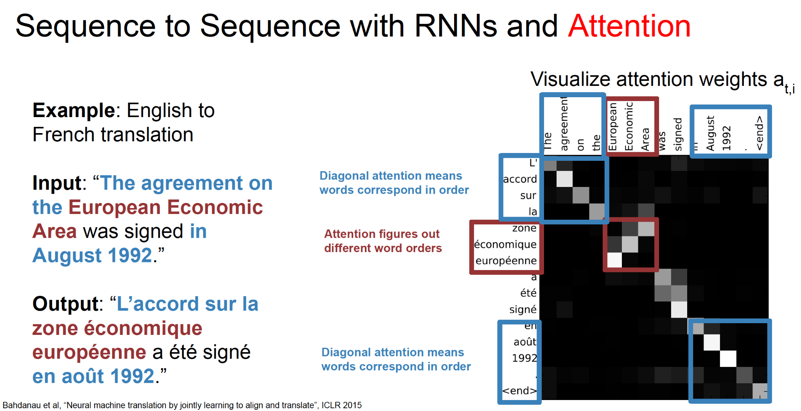
RNN and Attention

Slide 22
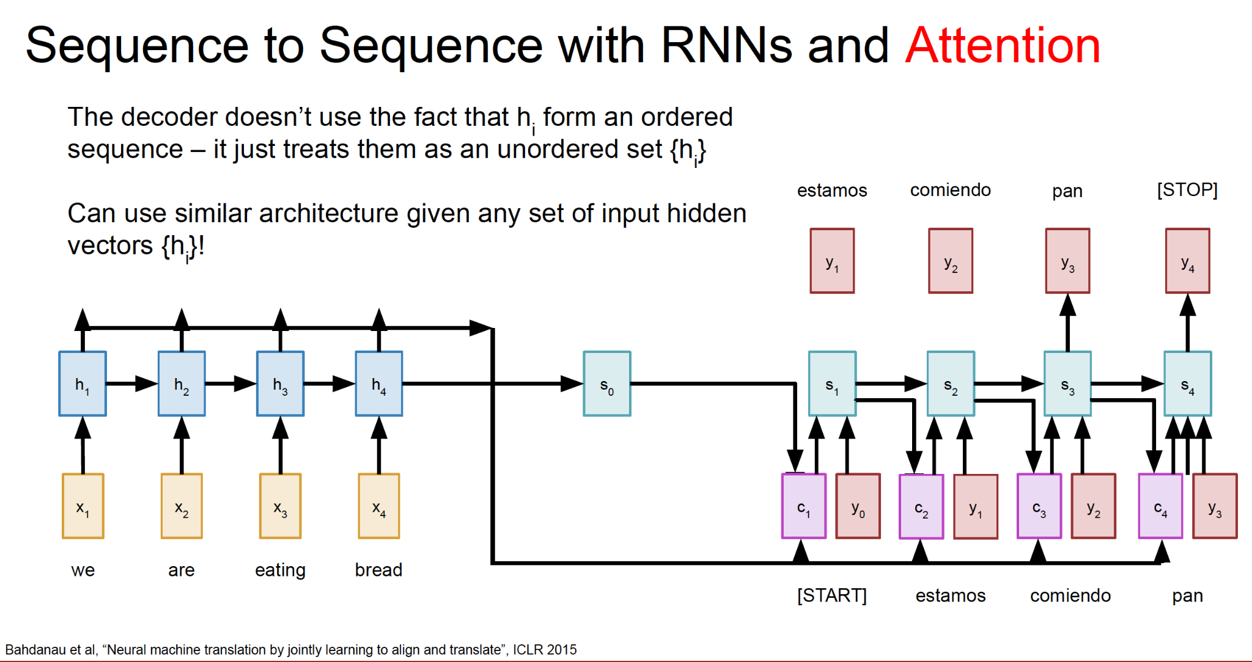
RNN and Attention

Slide 23
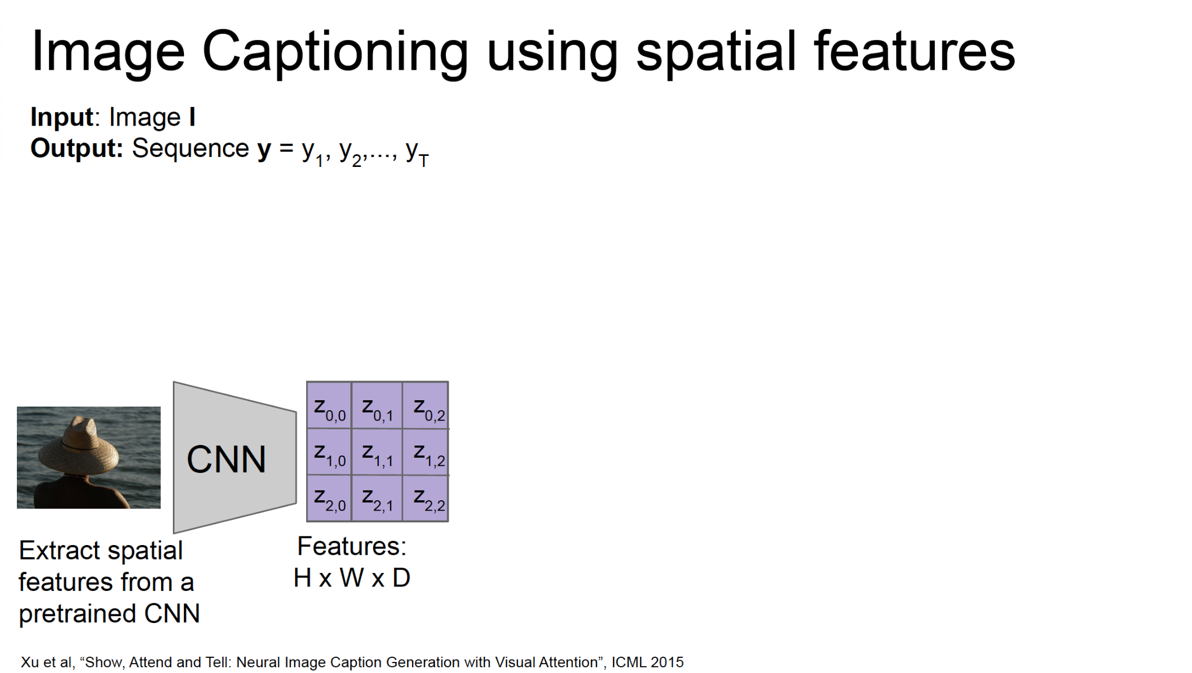
Image captioning

Slide 24
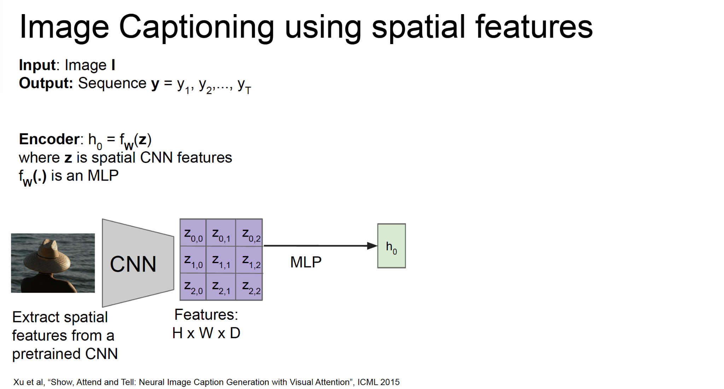
Image captioning

Slide 25
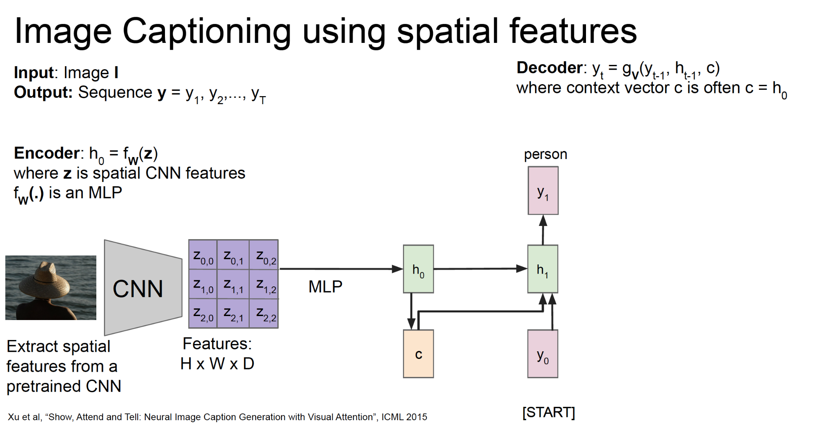
Image captioning

Slide 26
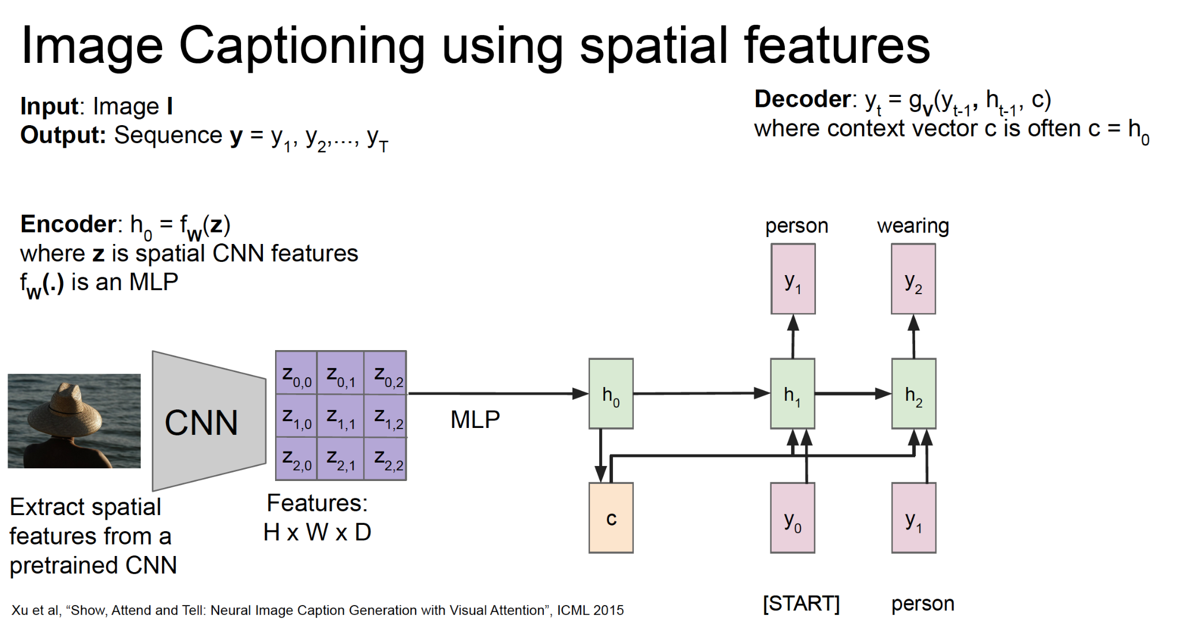
Image captioning

Slide 27
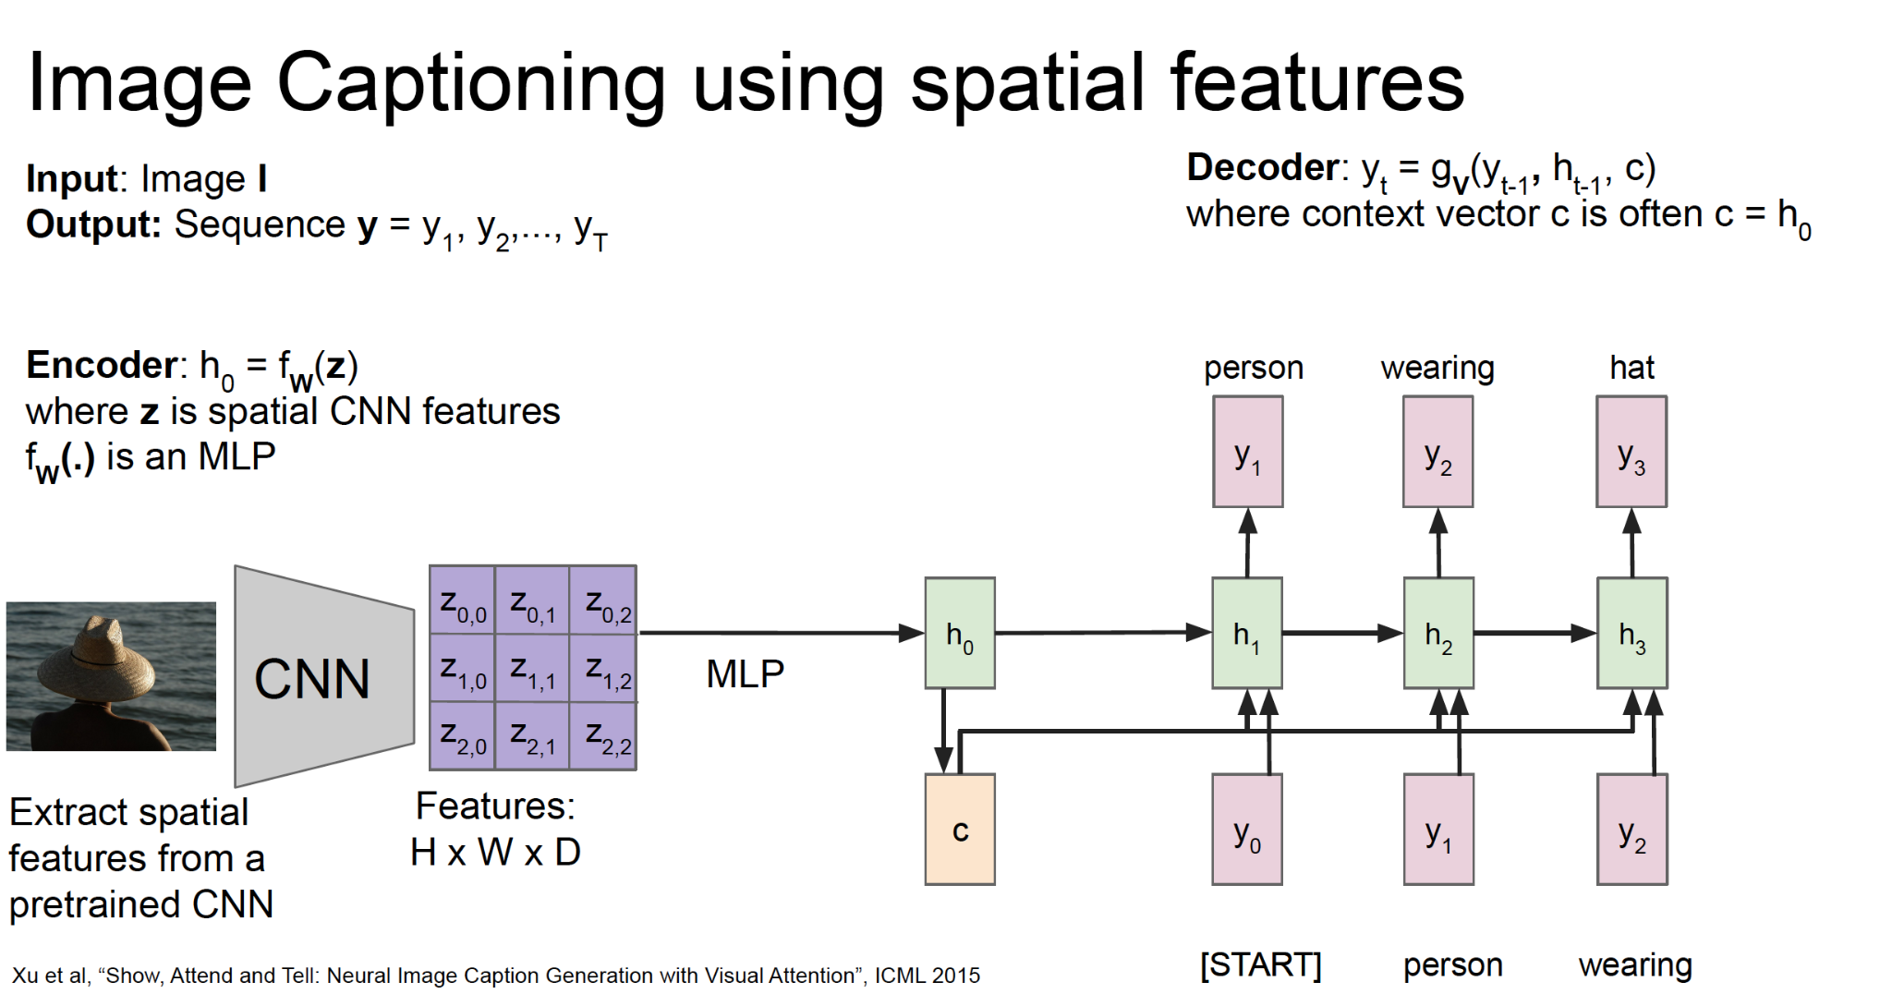
Image captioning

Slide 28
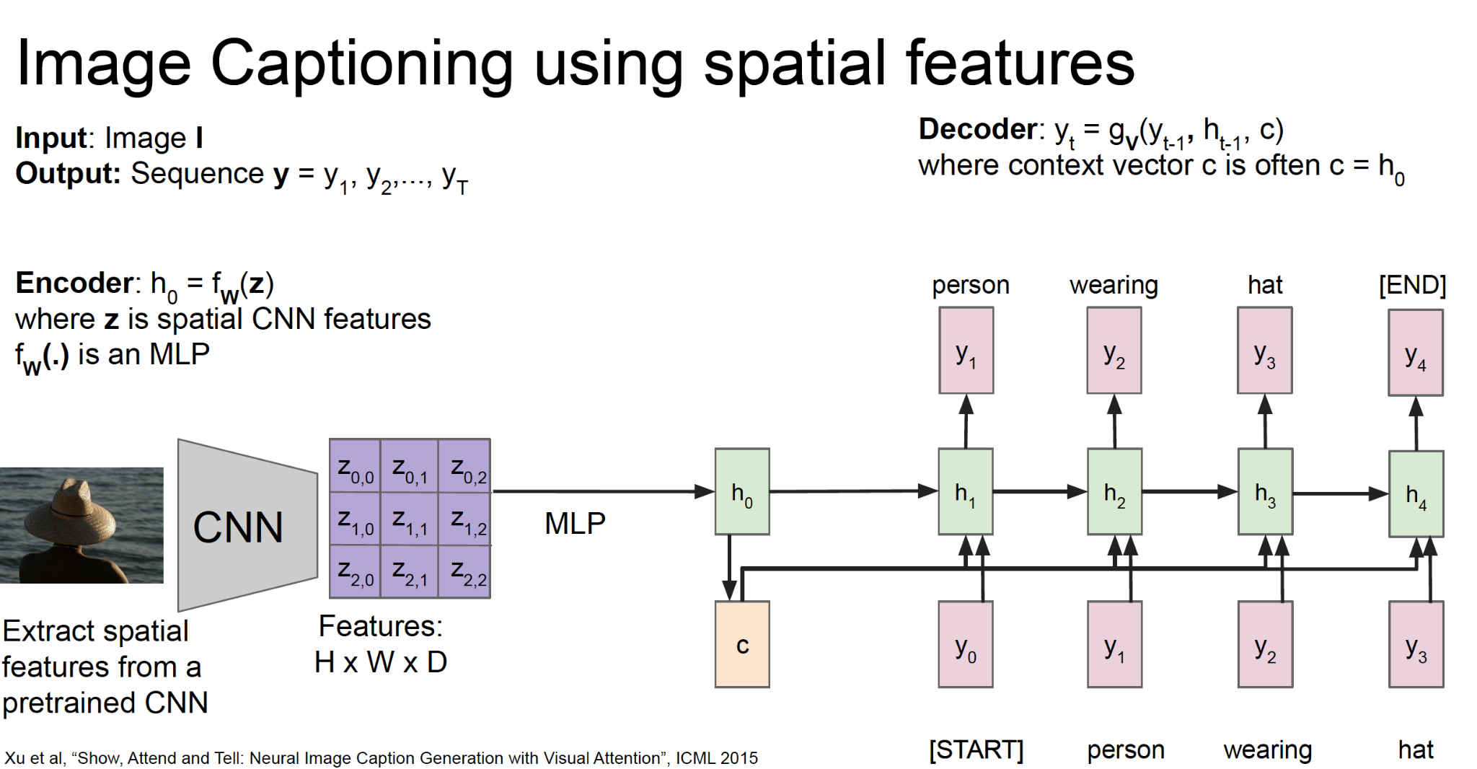
Image captioning

Slide 29
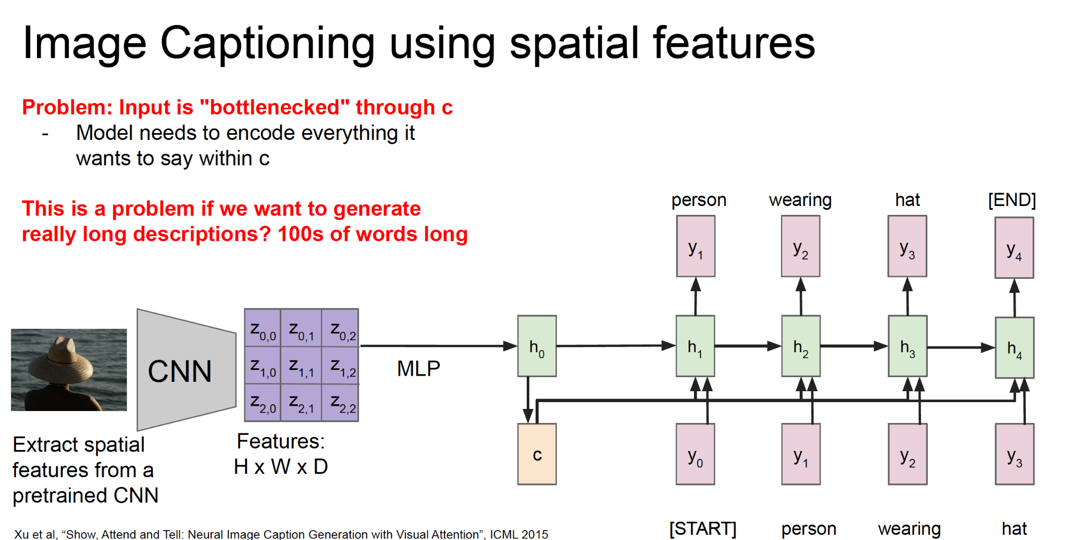
Image captioning

Slide 30
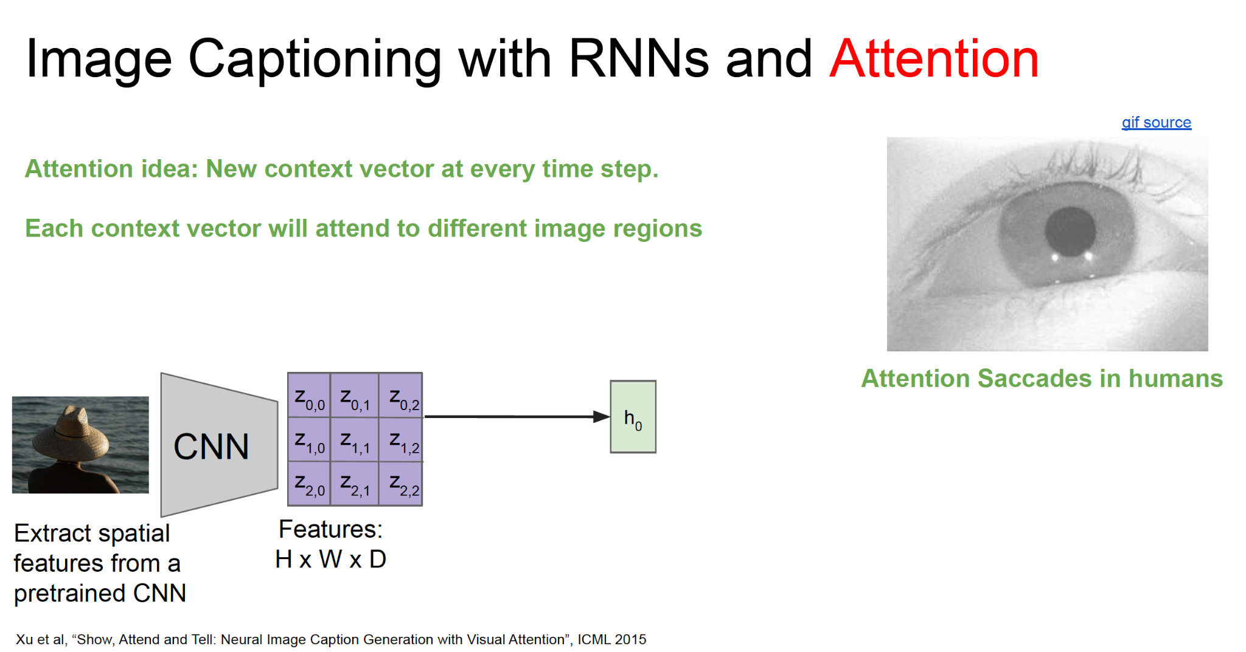
Image captioning

Slide 31
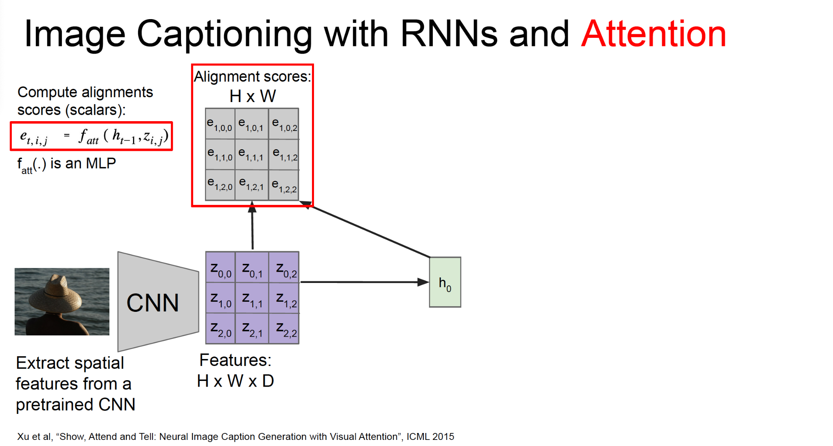
Image captioning

Slide 32
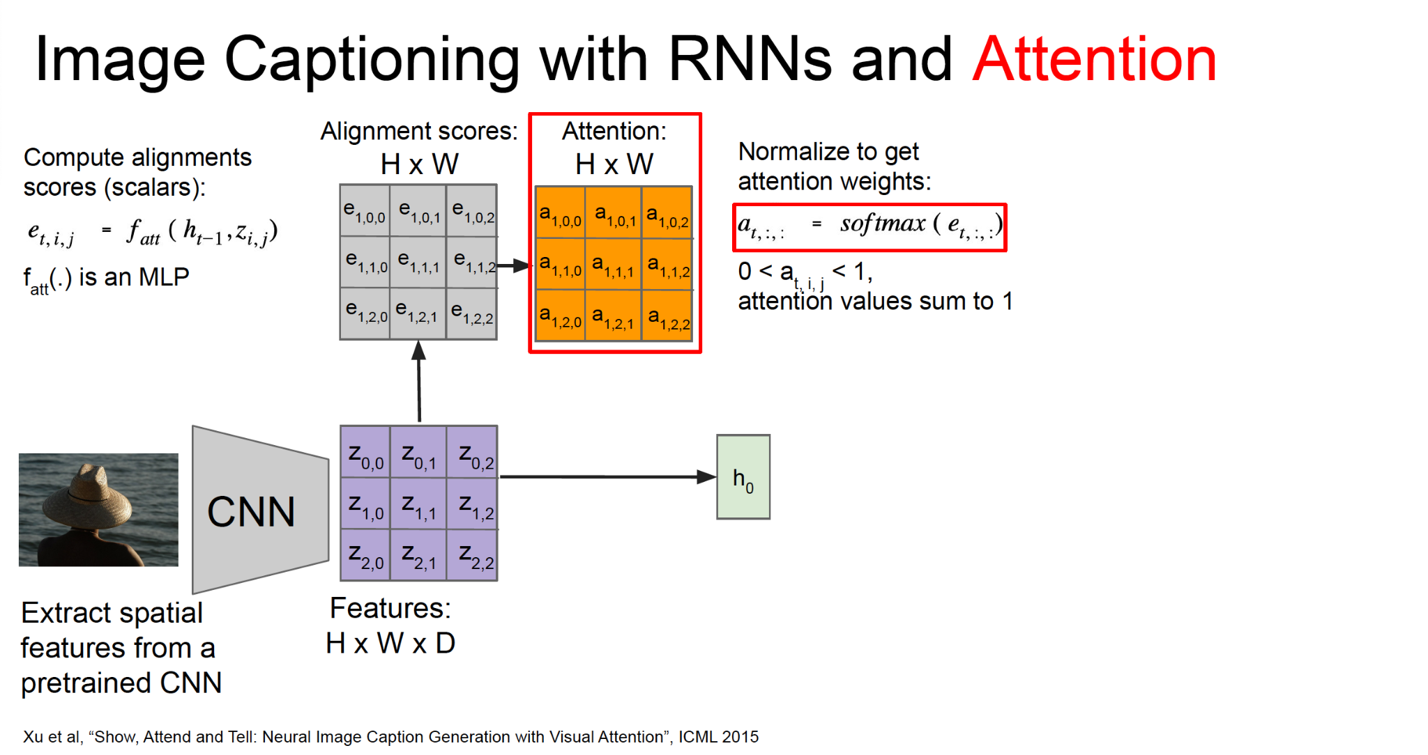
Image captioning

Slide 33
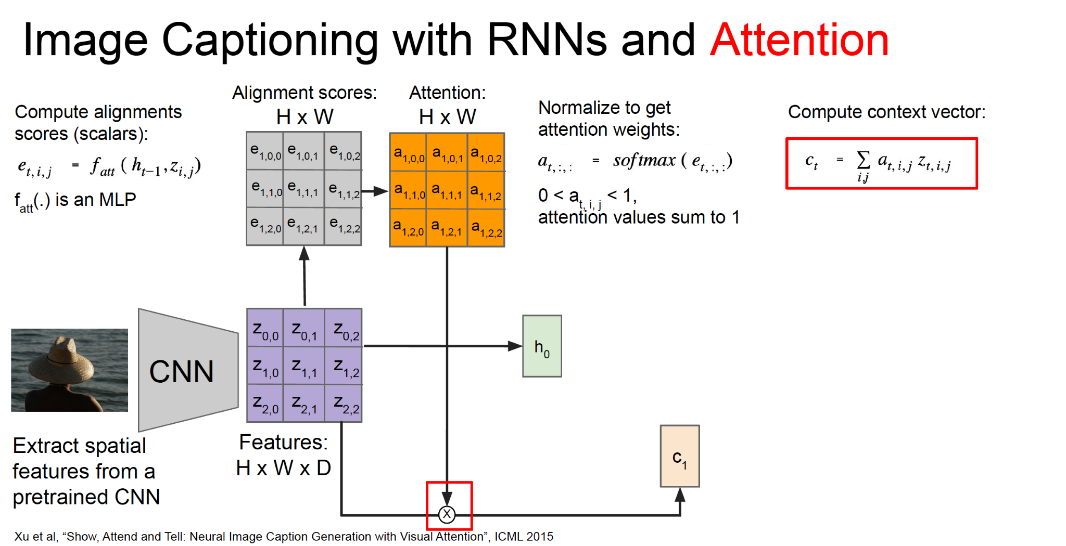
Image captioning

Slide 34
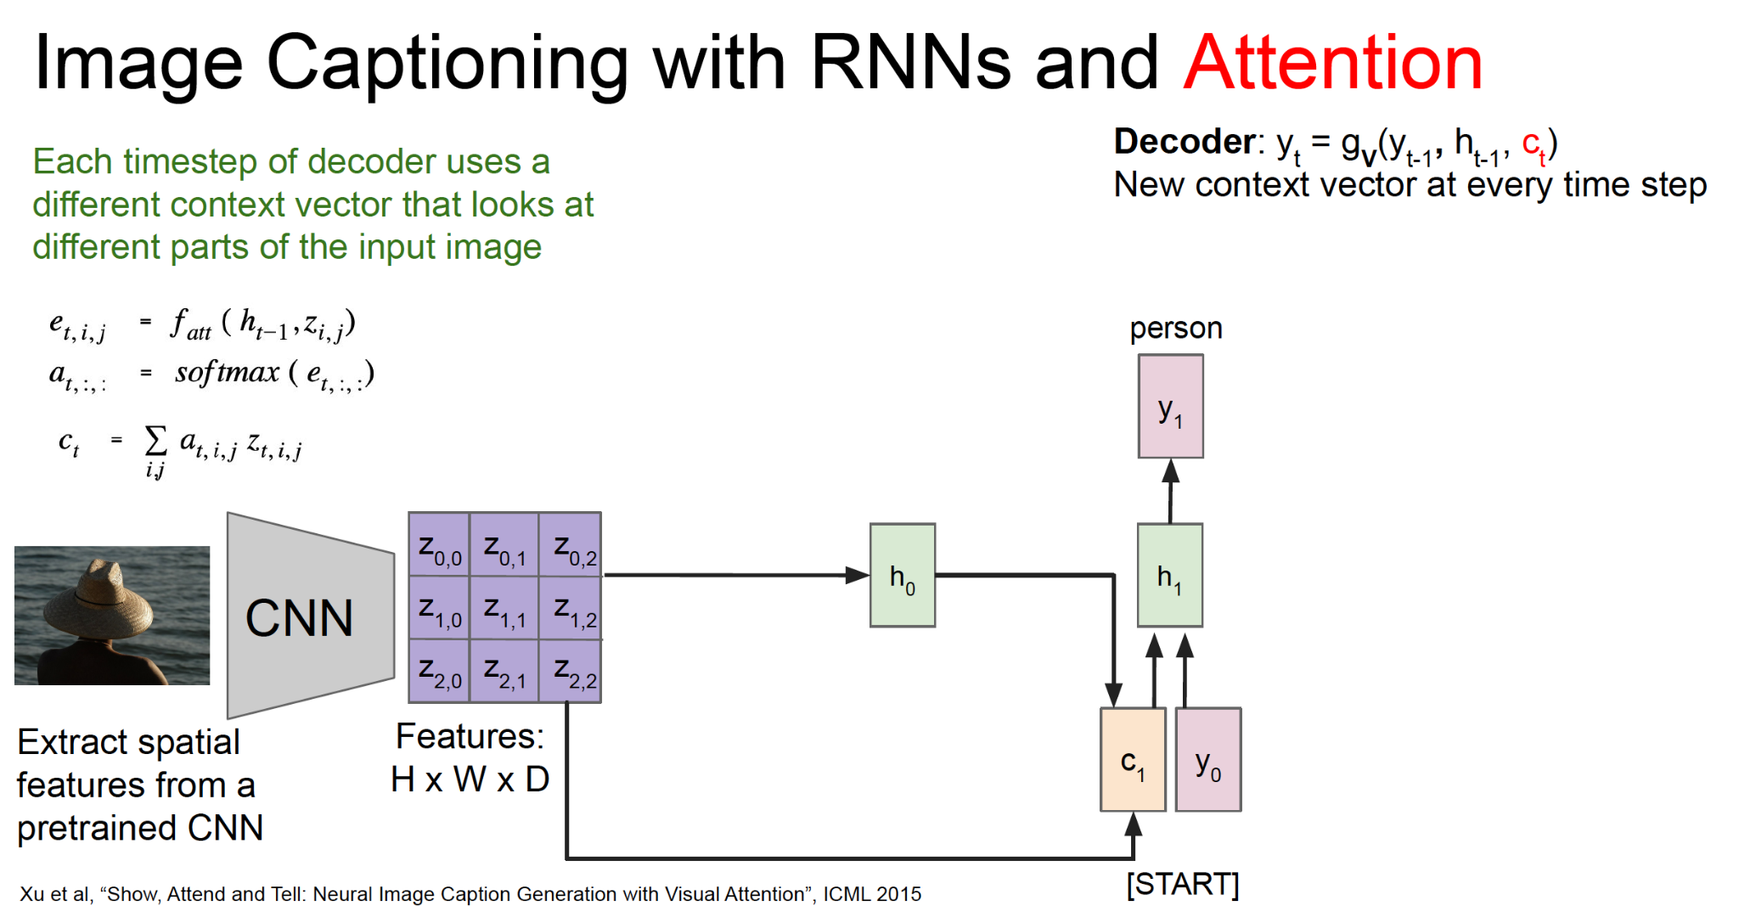
Image captioning

Slide 35
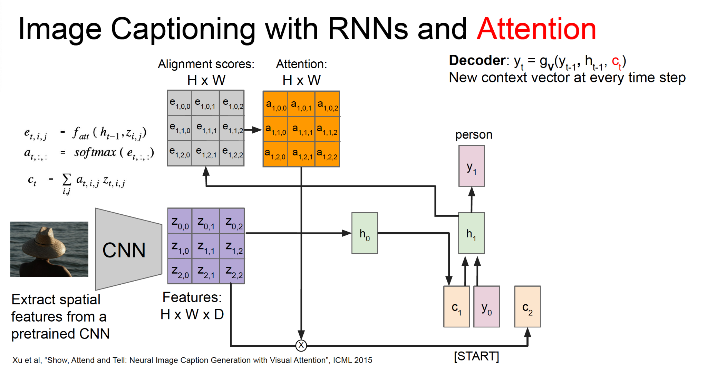
Image captioning

Slide 36
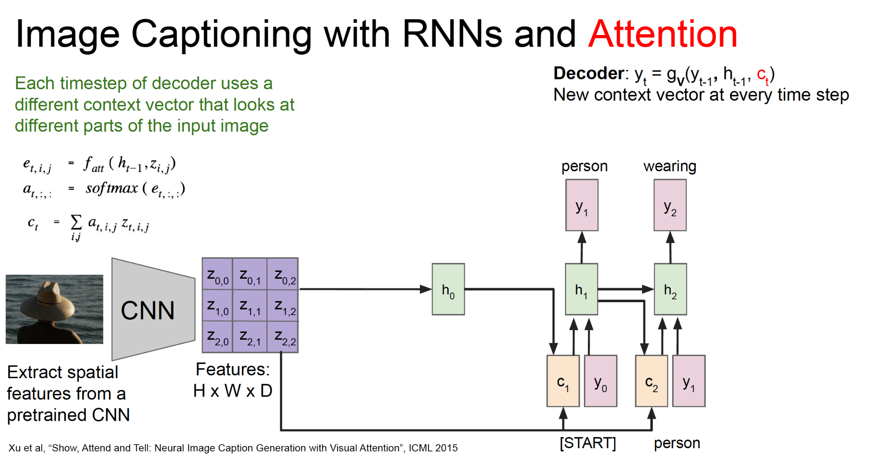
Image captioning

Slide 37
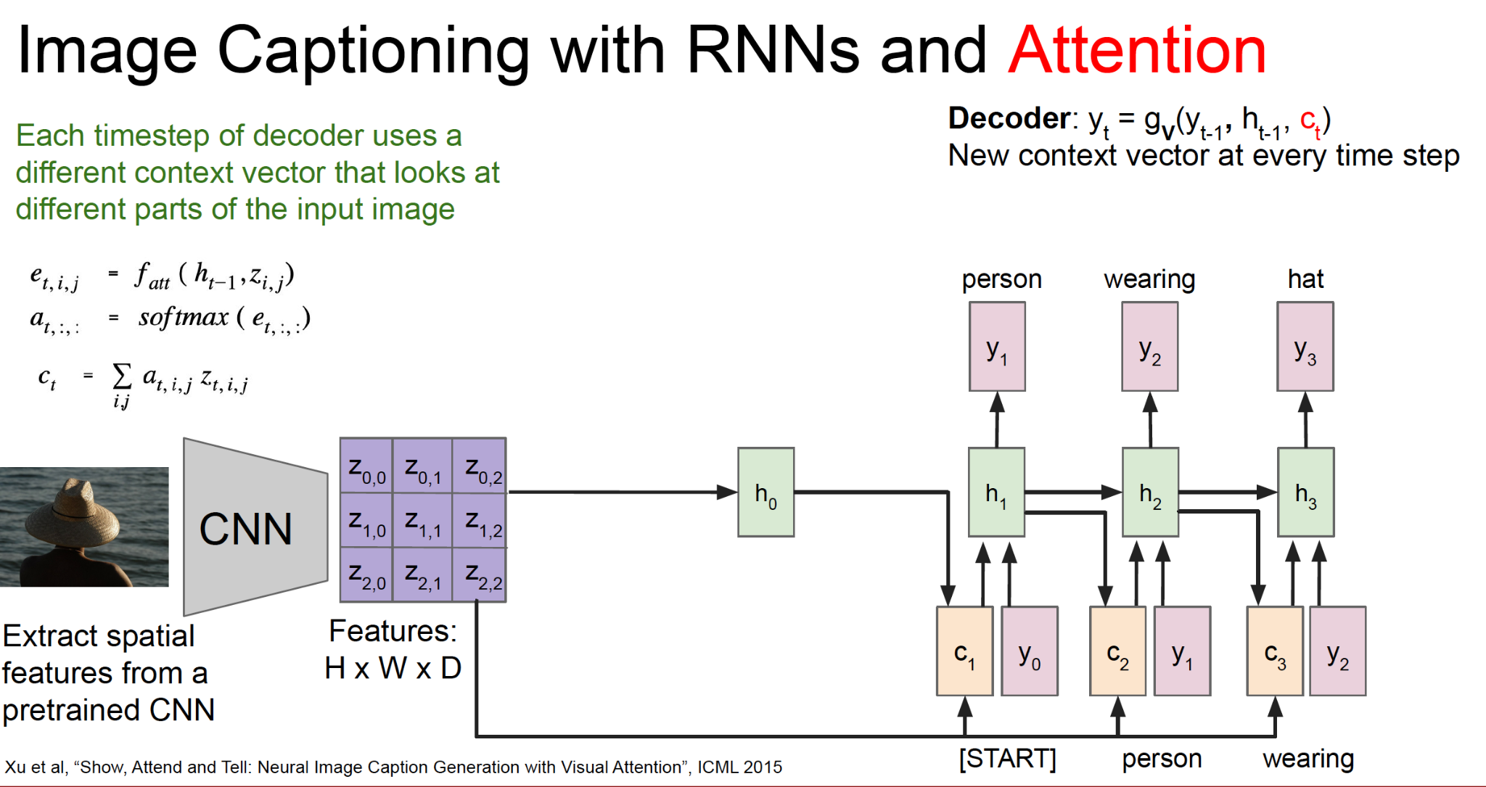
Image captioning

Slide 38
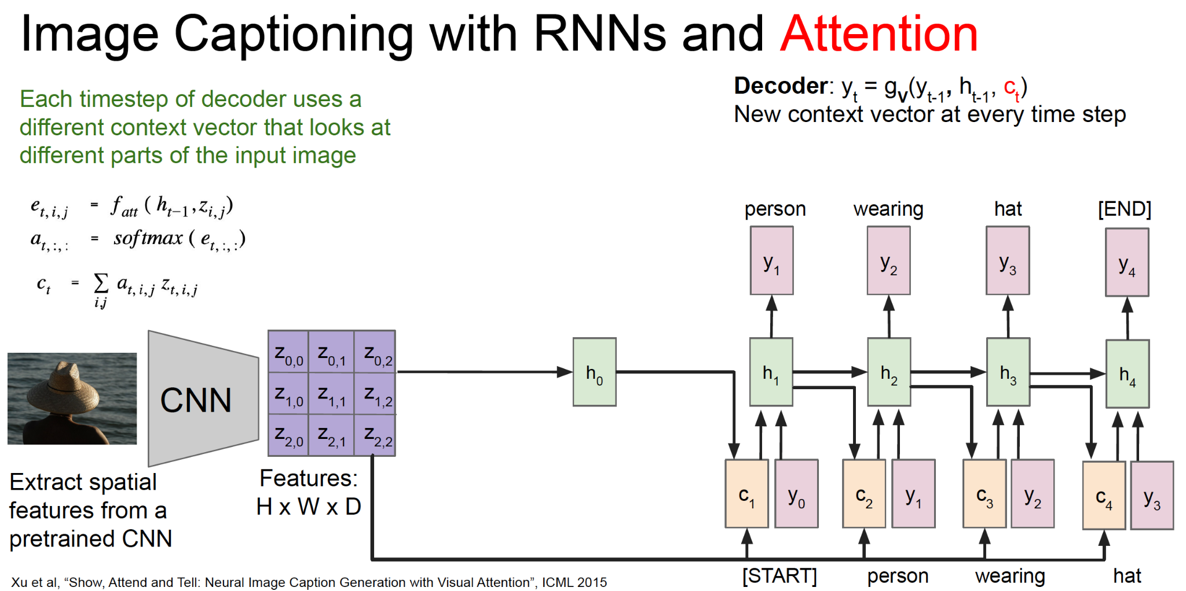
Image captioning

Slide 39
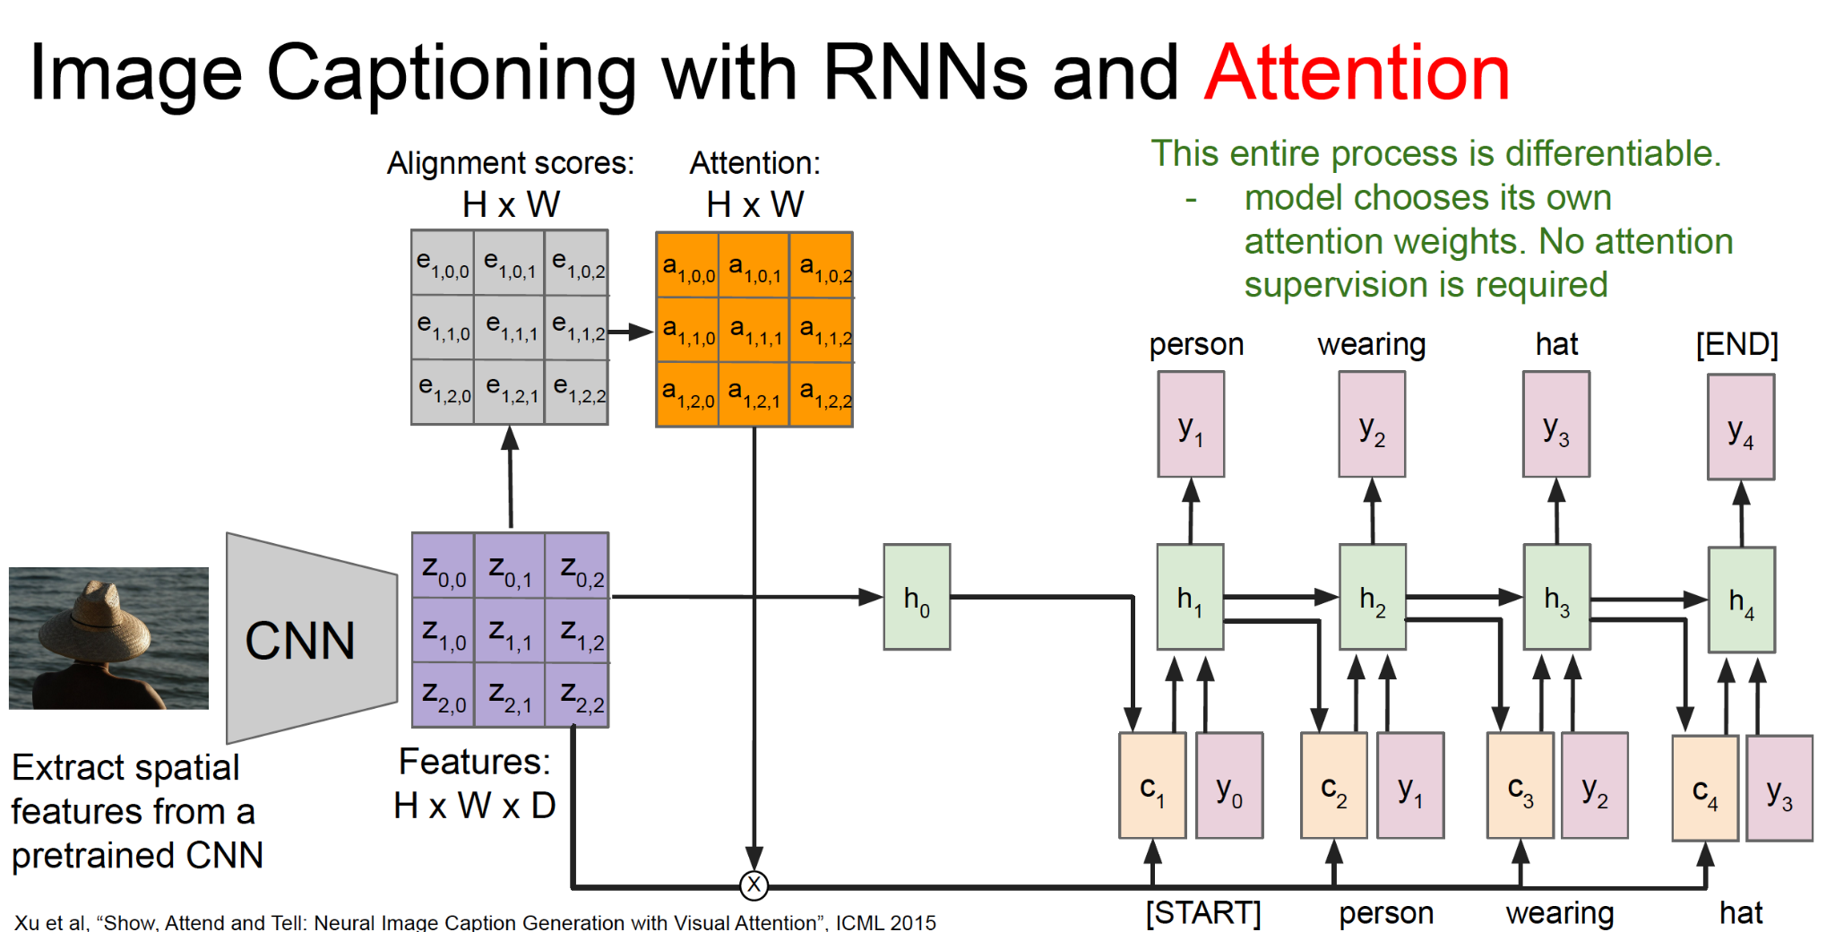
Image captioning

Slide 40
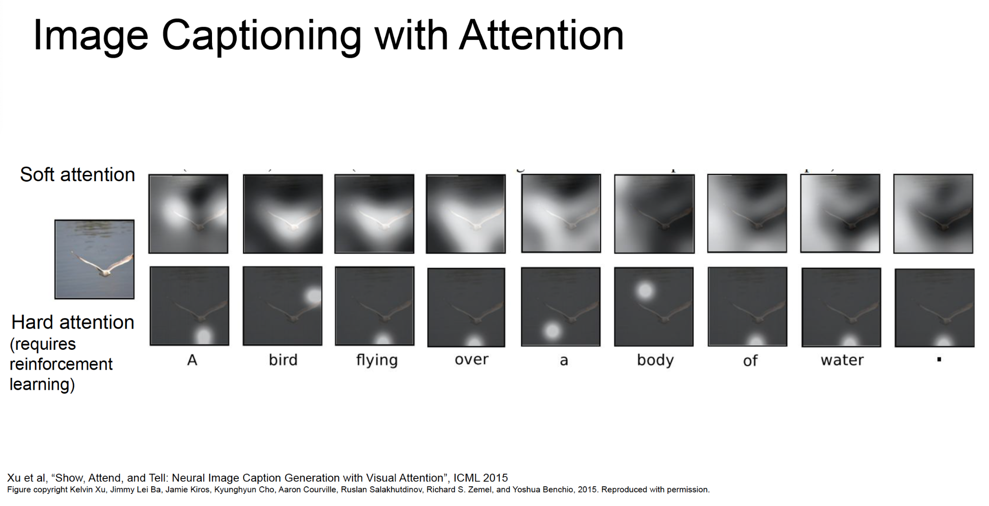
Image captioning

Slide 41
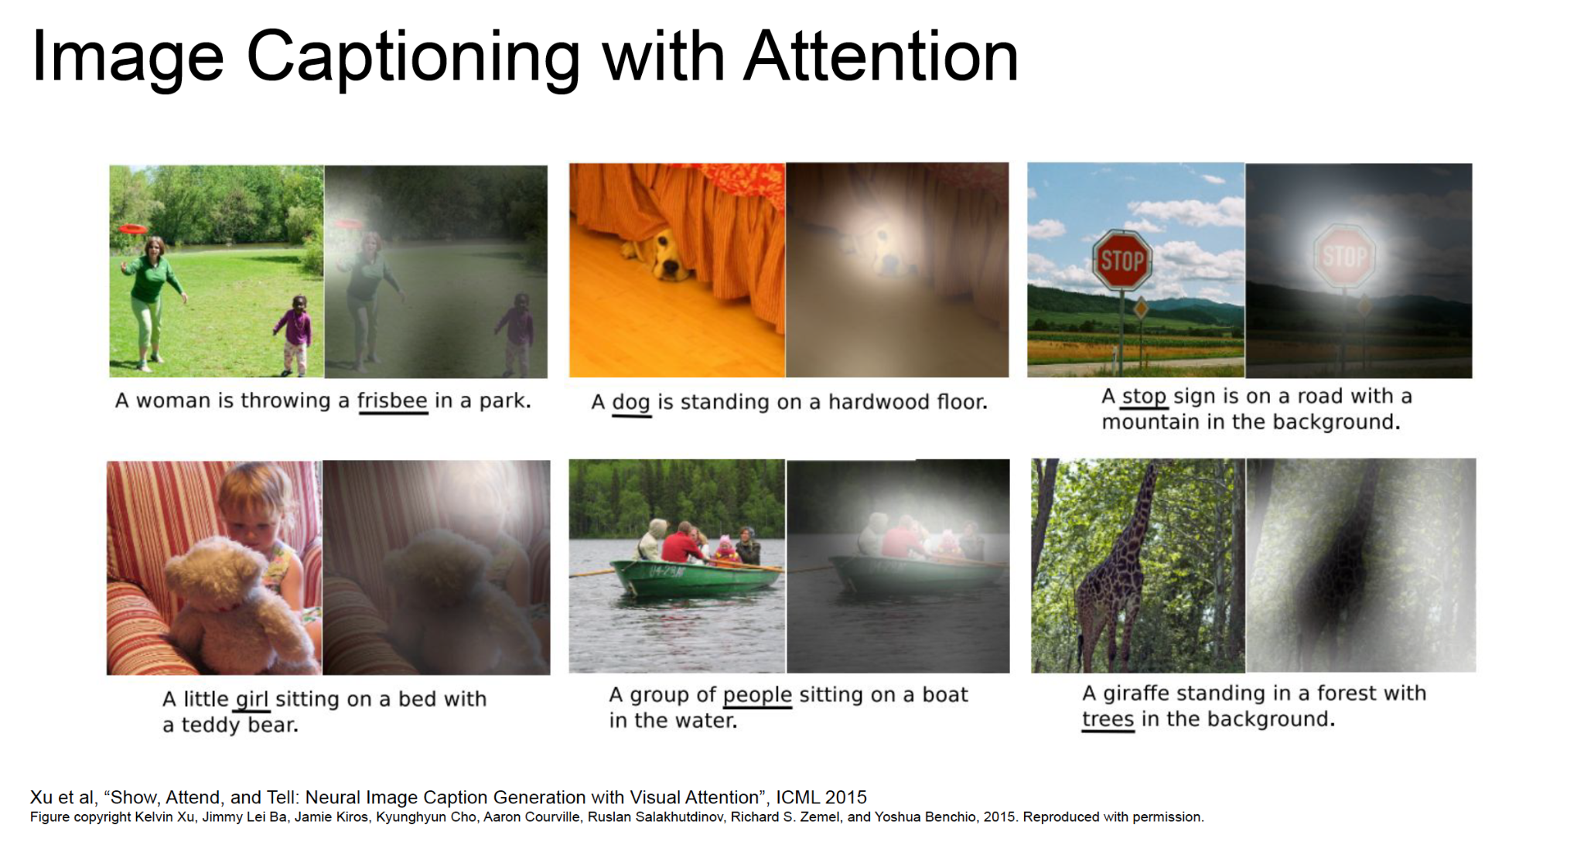
Image captioning

Slide 42
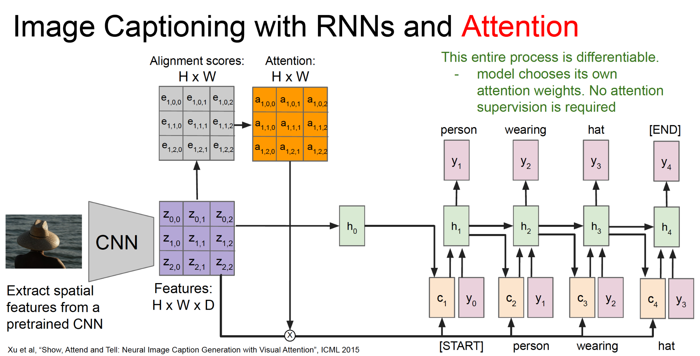
Image captioning

Slide 43
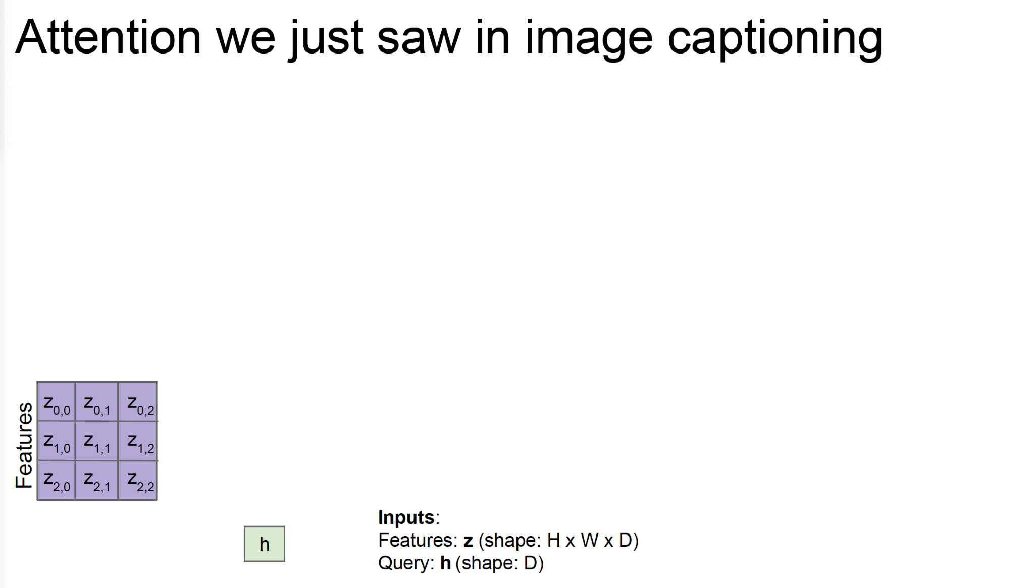
Attention

Slide 44
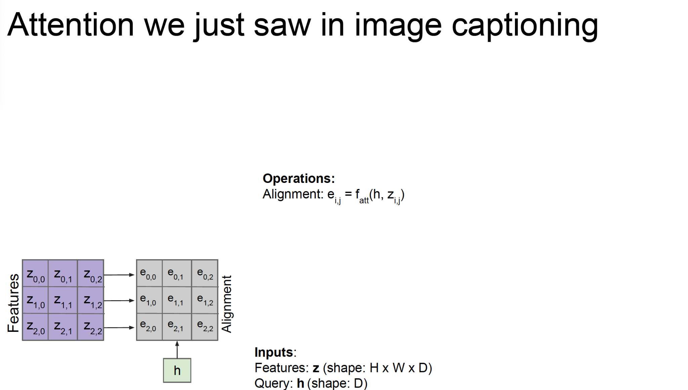
Attention

Slide 45
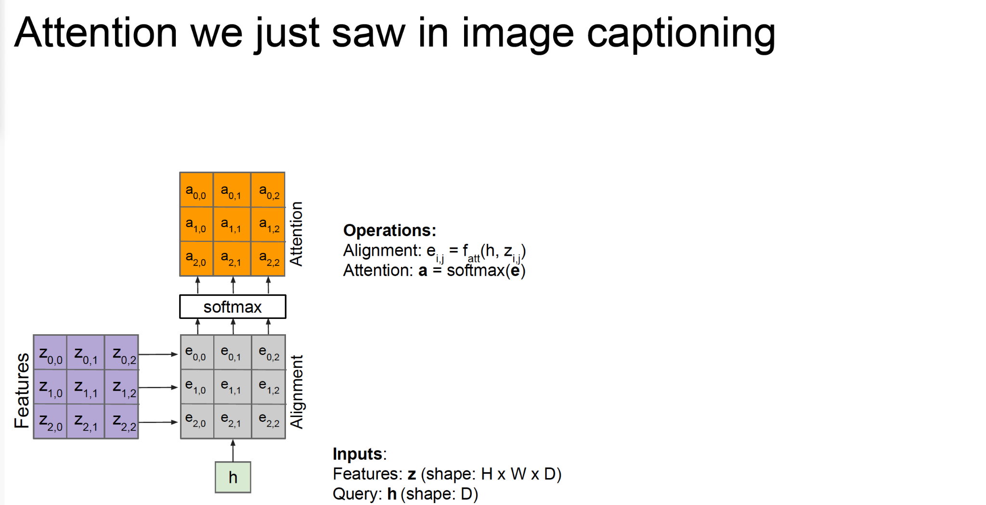
Attention

Slide 46
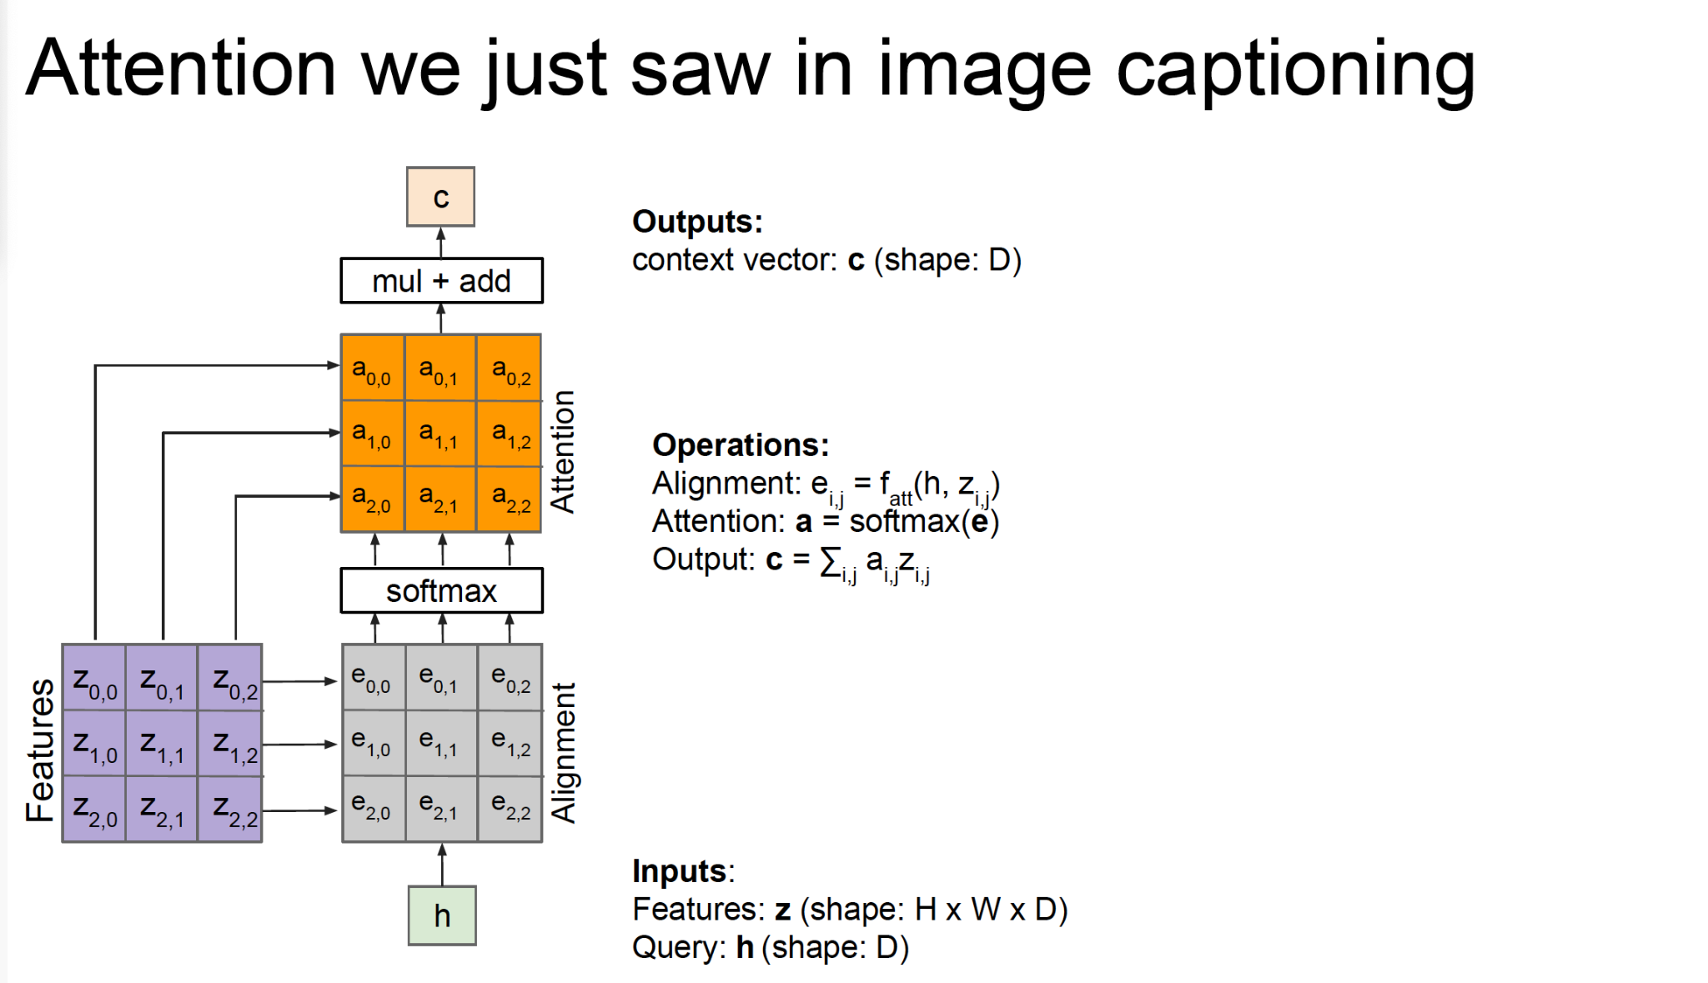
Attention

Slide 47
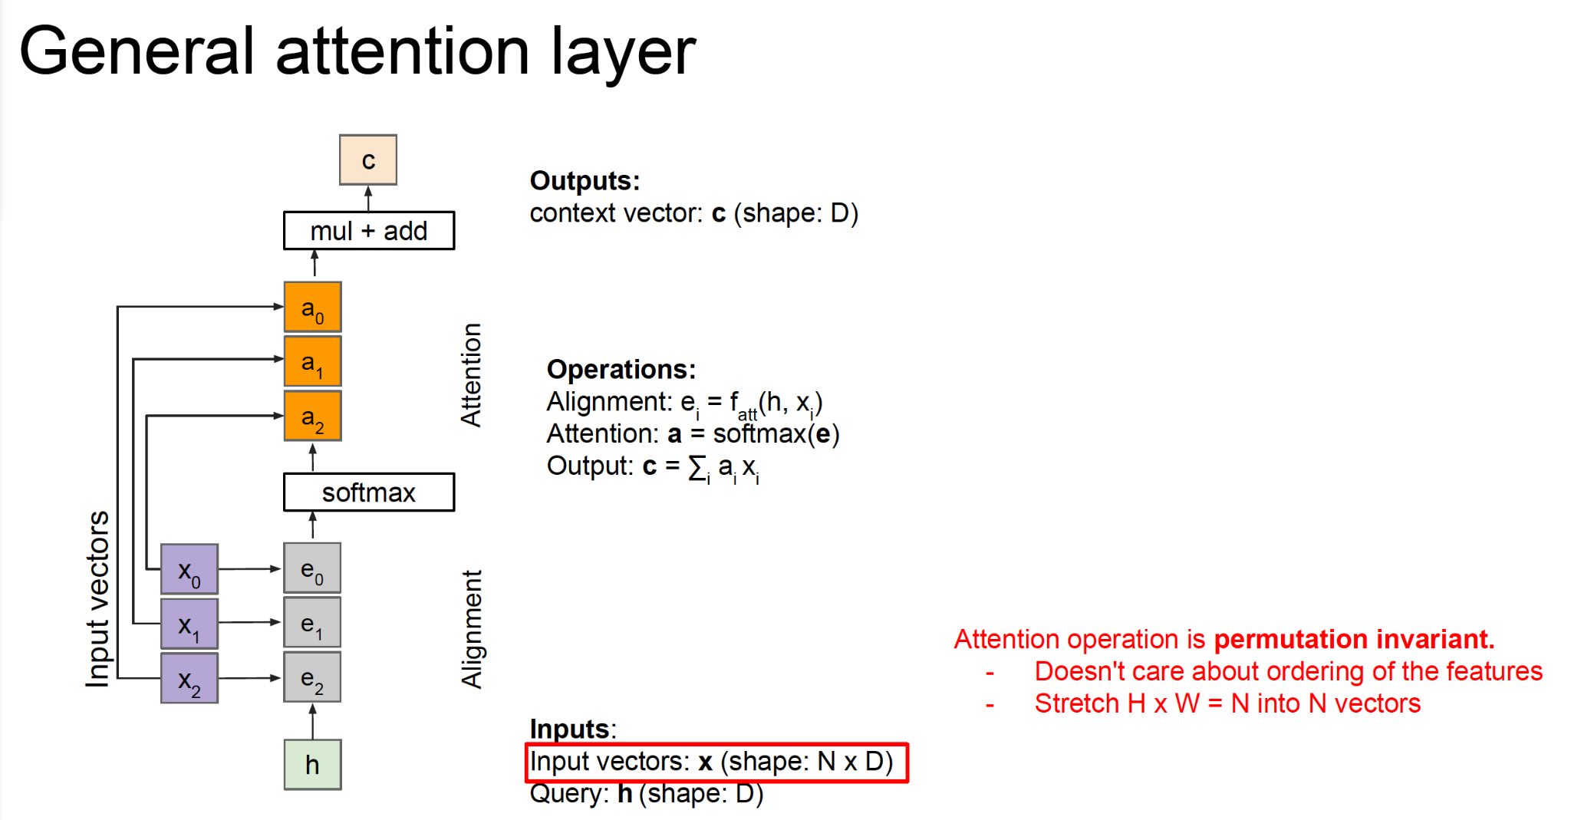
Attention

Slide 48
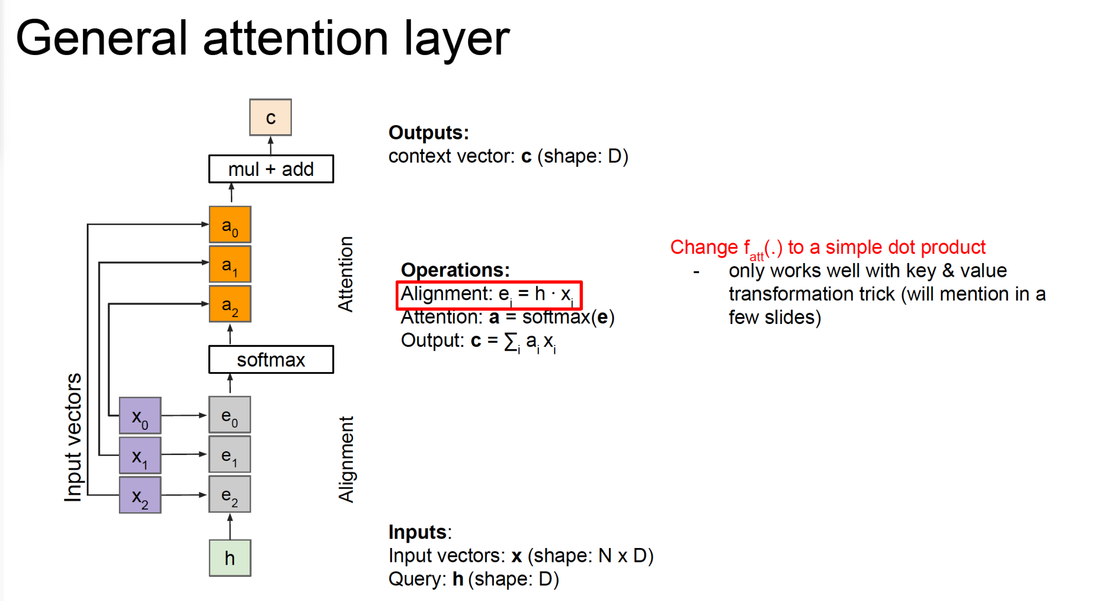
Attention

Slide 49
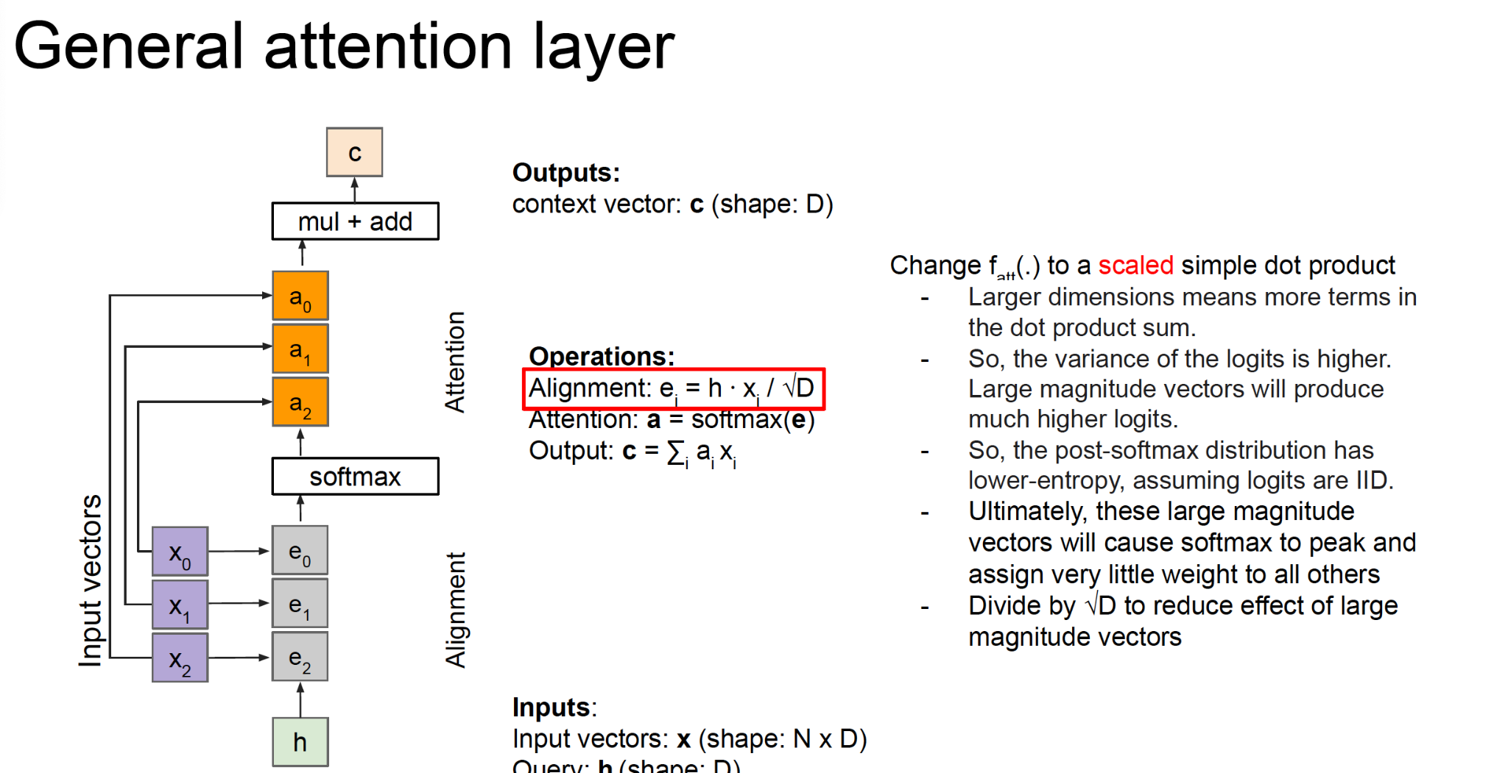
Attention

Slide 50
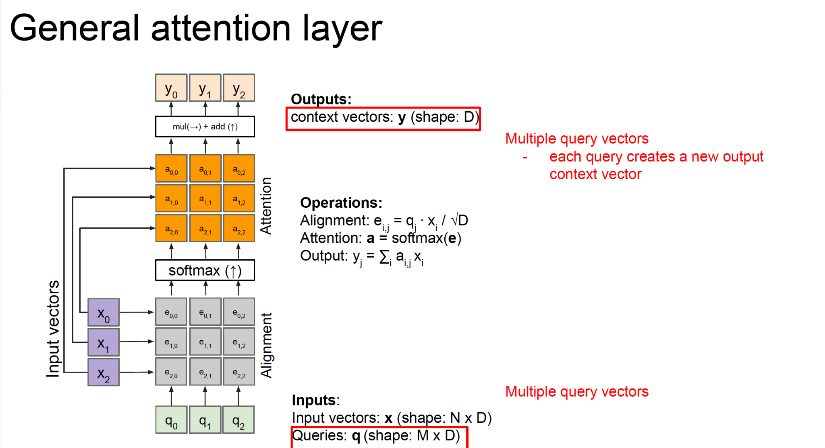
Attention

Slide 51
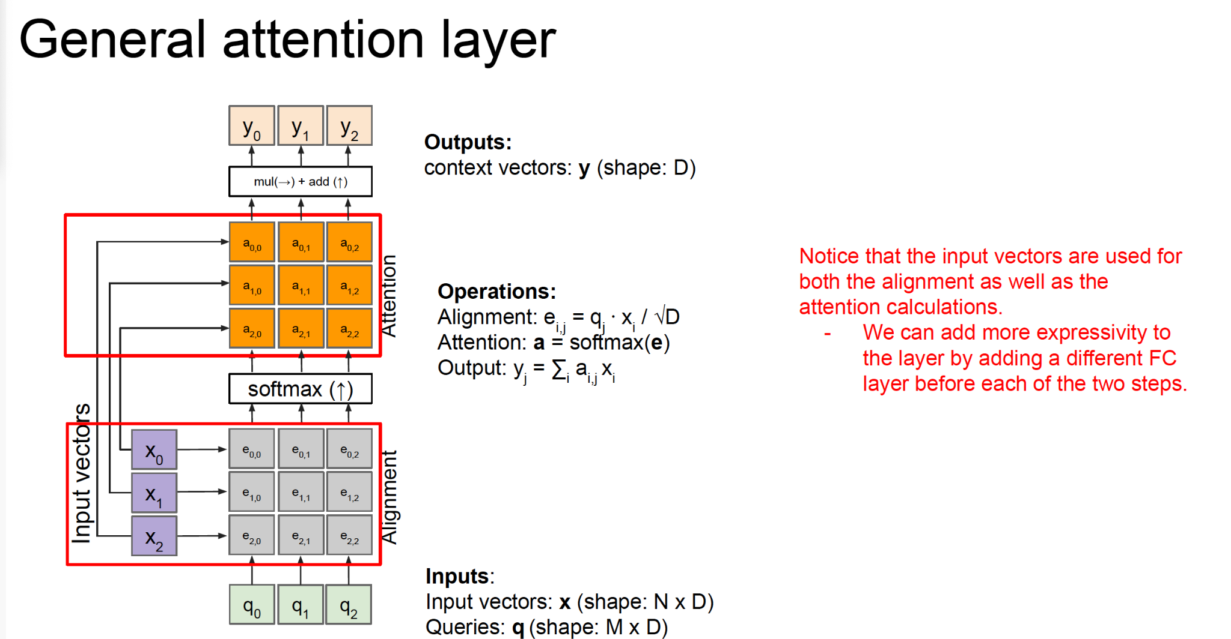
Attention

Slide 52

Attention

Slide 53

Attention

Slide 54

Attention

Slide 55

Self attention layer

Slide 56

Self attention layer

Slide 57

Self attention layer

Slide 58

Self attention layer

Slide 59

Positional encoding

Slide 60

Positional encoding

Slide 61

Positional encoding

Slide 62

Positional encoding

Slide 63

Mask Self-attention layer

Slide 64

Multi-Head Self-attention layer

Slide 65

Attention

Slide 66

Attention

Slide 67

Self-attention

Slide 68

Self-attention

Slide 69

Self-attention

Slide 70

Self-attention

Slide 71

Self-attention

Slide 72

RNN vs Transformer

Slide 73

Self-attention

Slide 74

Self-attention

Slide 75

Transformer

Slide 76

Transformer

Slide 77

Transformer

Slide 78

Transformer

Slide 79

Transformer

Slide 80

Transformer

Slide 81

Transformer

Slide 82

Transformer

Slide 83

Transformer

Slide 84

Transformer

Slide 85

Transformer

Slide 86

Transformer

Slide 87

Transformer

Slide 88

Transformer

Slide 89

Transformer

Slide 90

Transformer

Slide 91

Transformer

Slide 92

Transformer

Slide 93

Transformer

Slide 94

Transformer

Slide 95

Transformer

Slide 96

Transformer

Slide 97

Transformer

Slide 98

Transformer

Slide 99

Summary

Slide 100
Questions?
Dr.Shruti Kshirsagar
Kshirsagarshruti1@gmail.com

Slide 101
References
1.https://ift6135h18.files.wordpress.com/2018/02/05_rnn.pdf
2.https://web.stanford.edu/class/cs224n/readings/cs224n-self-attention-transformers-2023_draft.pdf
3.http://cs231n.stanford.edu/2021/slides/2021/lecture_11.pdf
4.https://www.dropbox.com/s/e244jw50gv12498/Attention%20Models%20in%20Deep%20Learning.pdf?dl=0
5.https://www.dropbox.com/s/7sov3snzt2jcefc/SelfAttentionAndTransformers.pdf?dl=0

